Slide 1




Combined Oral contraception
RM conference: 24 June 2022
F1 Rakchanok Boonpiam Aj.Ubol Saeng-anan

Slide 2



What is COC
How does COC work
How is COC use
Incorrect use of COC
Non-contraceptive benefit
Contents
Health risk
Side effect
When to stop COC Planning pregnancy
Use of COC in perimenopause

Slide 3
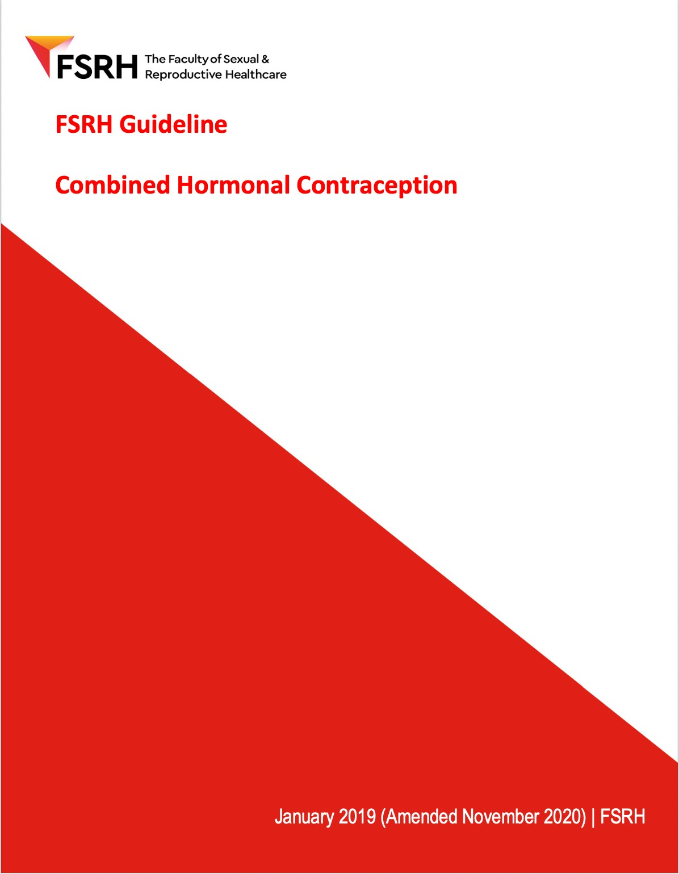
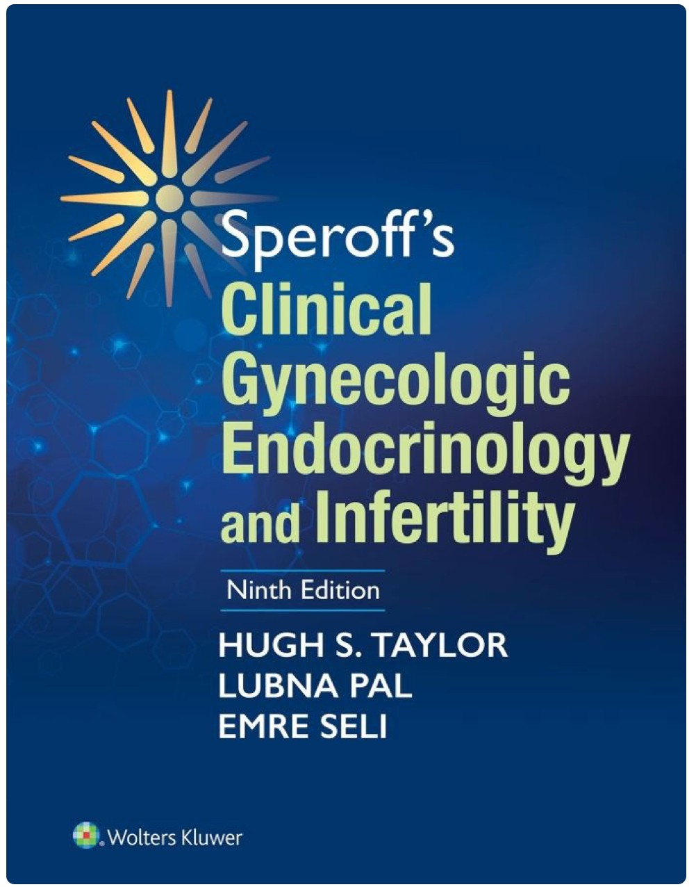
References

Slide 4


What is COC ???
Estrogen
Progestogen

Slide 5
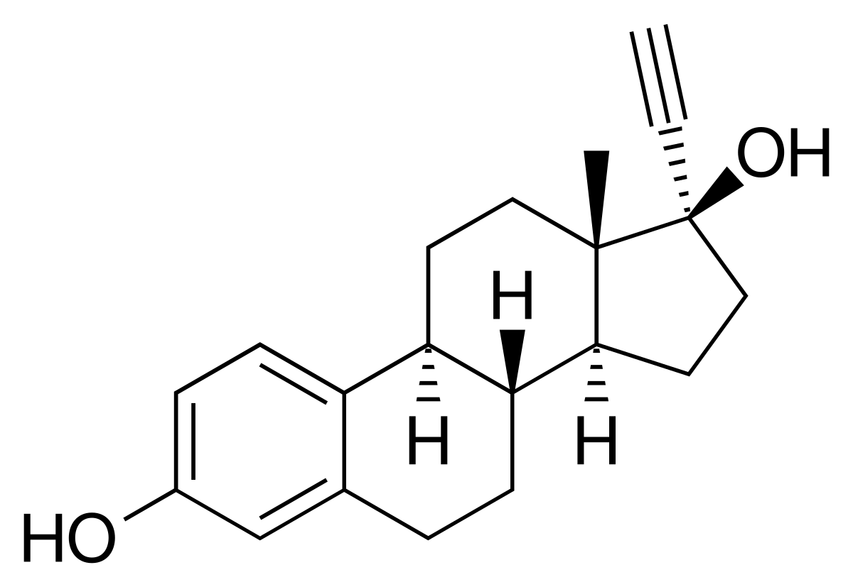
Estrogen
Ultra low
Low
High
20
50
Microgram
Ethinyl estradiol[EE]

Slide 6




Progestogen
Norethindrone Medroxyprogesterone acetate Chlormadinone acetate
Levonorgestrel
1st generation
2nd generation
3rd generation
4th generation
Desogestrel Gestodene Norgestimate Etonorgestrel
Dienogest Drospirenone Nomegestol acetate

Slide 7
Progestin |  | Progesto- geruc | Anti-gonado- tropic | Anti- estrogenic | Estro- geruc | Andro- geruc | Anti-andro- gemc | Gluco- corticoid | Anti- mineralo-
 |  |  |  |  |  |  |  |  | corticoid
Progesterone Dydrogesterone |  | + + | + | + + |  |  | ± ± | + | + ±
Medrogestone |  | + | + | + |  |  | ±
Chlormadinone acetate |  | + | + | + |  |  | + | +
Cyproterone acetate |  | + | + | + |  |  | ++ | +
Megestrol acetate |  | + | + | + |  | ± | + | +
Medroxy-progesterone-acetate |  | + | + | + |  | ± |  | +
19-Nor-progesterone-derivatives Nomegestrol acetate |  | + | + | + |  |  | ±
Promegestone |  | + | + | +
Trimegestone |  | + | + | + |  |  | ± |  | ±
Drospirenone |  | + | + | + |  |  | + |  | +
19-Nortestosterone | derivatives
Norethisterone |  | + | + | + | + | +
Lynestrenol |  | + | + | + | + | +
Norethinodrel Levonorgestrel Norgestimate 3-Keto-desogestrel Gestoden Dienogest |  | ± + + + + + | + + + + + + | ± + + + + ± | + ± | ± + + + + | + | + | +
170:-Hydroxy-derivatives
Spirolactone-derivatives
Taken from reference [5,7,8,10-15]. (+)effective;(±) weakly effective;(-) not effective.
Schindler AE, Maturitas. 2008

Slide 8
Name/tablets | Estrogen | Progestogen 1st generation
Dafne/21 | EE 35mcg | Cyproterone acetate 2mg
Dianne/21
Sucee/28
OC-35/21
Beriz/21
Preme/21
B-lady/21

Slide 9
Name/tablets | Estrogen |  |  | Progestogen 1st generation
Belara/21 | EE 30 mcg |  |  | Chlomadinone acetate 2mg
Chariva/21 | EE | 30 | mcg
Lora/21 | EE | 20 | mcg | 2nd generatio Levonorgestrel 0.10mg
Microgynon/28 | EE | 30 | mcg
n

Slide 10
Name/tablets | Estrogen |  |  | Progestogen 3rd generation
Minny/21&28 | EE 20 mcg |  |  | Desogestrel 0.15mg
Mercilon/21&28 | EE | 20 | mcg
Marvelon/21&28 | EE | 30 | mcg
Minidoz/24+4 | EE | 15 | mcg | Gestodene 0.060mg
Meliane/21 | EE | 20 | mcg
Annylyn/28 | EE | 20 | mcg
Govana/21 | EE | 30 | mcg
10

Slide 11
Name/tablets | Estrogen |  |  | Progestogen 4th generation
Synfonia/24+4 | EE | 20 | mcg | Drospirenone 3mg
Yaz/24+4 | EE | 20 | mcg
Yazmin/21 | EE | 30 | mcg
Melodia/21 | EE | 30 | mcg
Justiva/21 | EE | 30 | mcg
Zoely/24+4 | EE | 15 | mcg | Nomegestrol 2.5mg

Slide 12


How does COC work ?
Inhibit FSH and LH secretion
>> Ovulation inhibition
Cervical mucus Endometrium Tubal motility
"Progestogen"

Slide 13
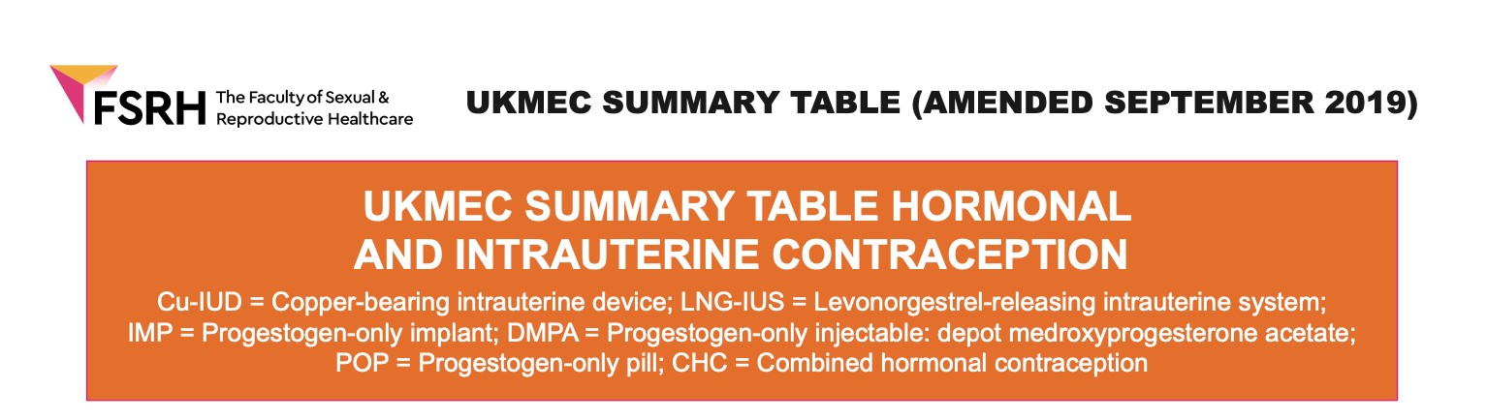
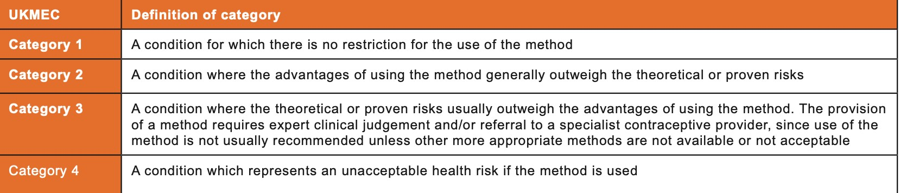
How is COC use ?

Slide 14


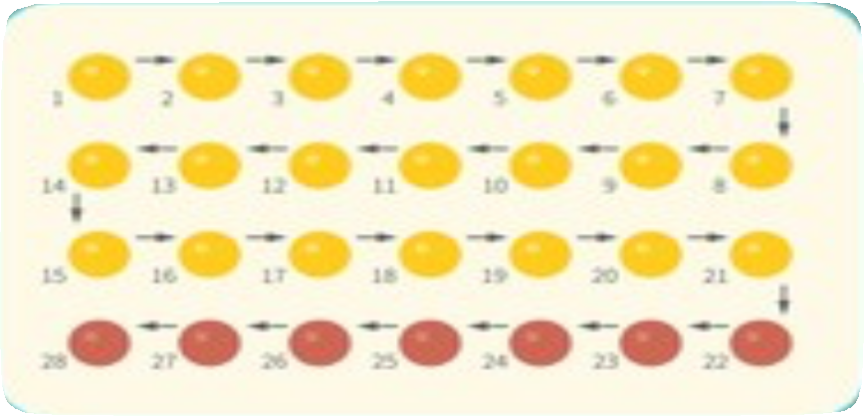




How is COC use ?
28 days cycle
21 daily active pills
7 days pill-free
๏ Hormone free interval 7days
๏ Risk of escape ovulation >> 24+4 tablets
๏ Bleeding may be heavy, painful or simply unwanted
๏ Interval may be associated with symptoms such as headache and mood change
Standard regimen
No health benefit from withdrawal bleeding Not a physiologic menstruation

Slide 15


How is COC use ?
Extended regimen:
Reduce the frequency of hormone-free interval
Continuous regimen:
Abolish of hormone free interval
Tailored regimen
Safe and effective as standard regimen

Slide 16
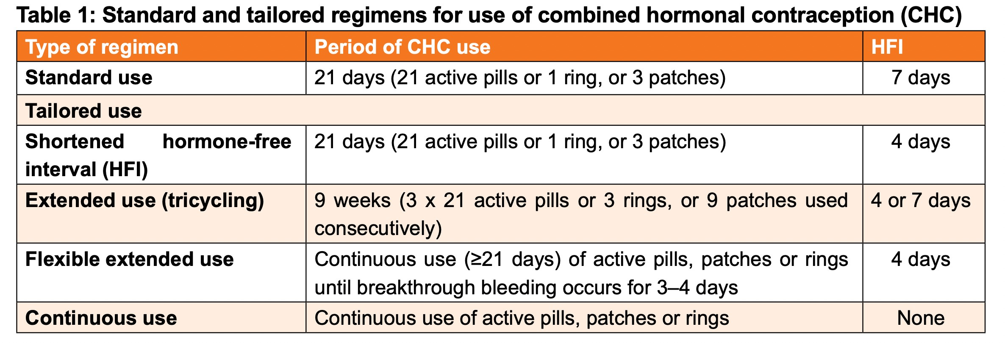
How is COC use ?
FSRH guideline:combined hormonal contraception, 2019

Slide 17
Table 2: Startin g combined hormonal contraception and requirement for additional
contraceptive precautions
- --- -
l 1c:.f ',,!111•'-'111'-'I iJU!I?u of:_!:_f.-J
- --
- ft;:r -
-
- - -
- -
f:TOl• 11U •ll I oli11It'• '-' o t jl•T,:J
1c:.f ',,!111( :..1111 '-'I iJU!Ijl'
-
l₋'l•'-'..-.lllU•lll-'t
I i..".111,;..\f"tjj r;f:\•--i.
1911• ... •111t--i't:111911 :..I
1'•'j 1''-'1.JU!.i -i f:l•.
'lr.f:\Tj..-\
- -
f:"ii 1.!.!..
•
,_._...-,- r.u1ro-1l\•r.1-r,:i 1--£1· 1
-
r.11:..11IO I •1'-'-'1.....I .₋.I
Women having natural menstrual cycles
Up to and including Day 5*
No
No
At any other time ifit isreasonably Yes
Consider
.certain she is not pregnant or a HSUPT is negative
Women who are amenorrhoeic
At any time if it is reasonably certain she is not pregnant and/ or a HSUPT is negative
Yes
Consider
After LNG-EC
Immediately
Yes
Yes
After UPA-EC
5 days after taking UPA-EC
From 6 weeks following Yes childbirth
Yes
Yes
tAfter childbirth
(breastfeeding)
tAfter childbirth
breastfeeding)
Consider
(not
Without additional risk factors Yes for VTE:t:: from 3 weeks
following childbirth
Consider
With additional risk factors for Yes VTE:t:: from 6 weeks following childbirth
Up to and including Day 5* No following treatment
tAfter abortion, miscarriage, ectopic pregnancy or gestational
trophoblastic disease
Follow-up pregnancy testing as per local protocol after these pregnancies
After Day 5* if it is reasonably certain she is not pregnant
Yes
FSRH guideline:combined hormonal contraception, 2019

Slide 18

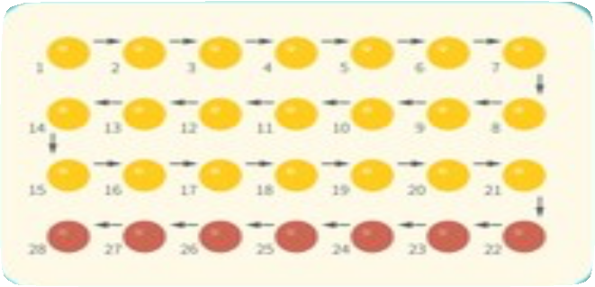
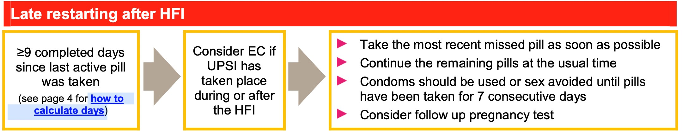
Incorrect use of COC
FSRH guideline:combined hormonal contraception, 2019

Slide 19
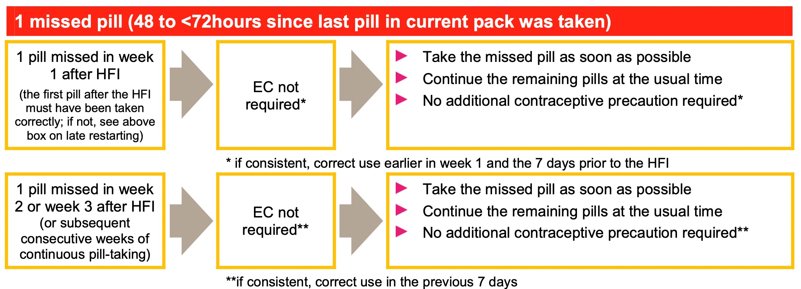
Incorrect use of COC
FSRH guideline:combined hormonal contraception, 2019

Slide 20
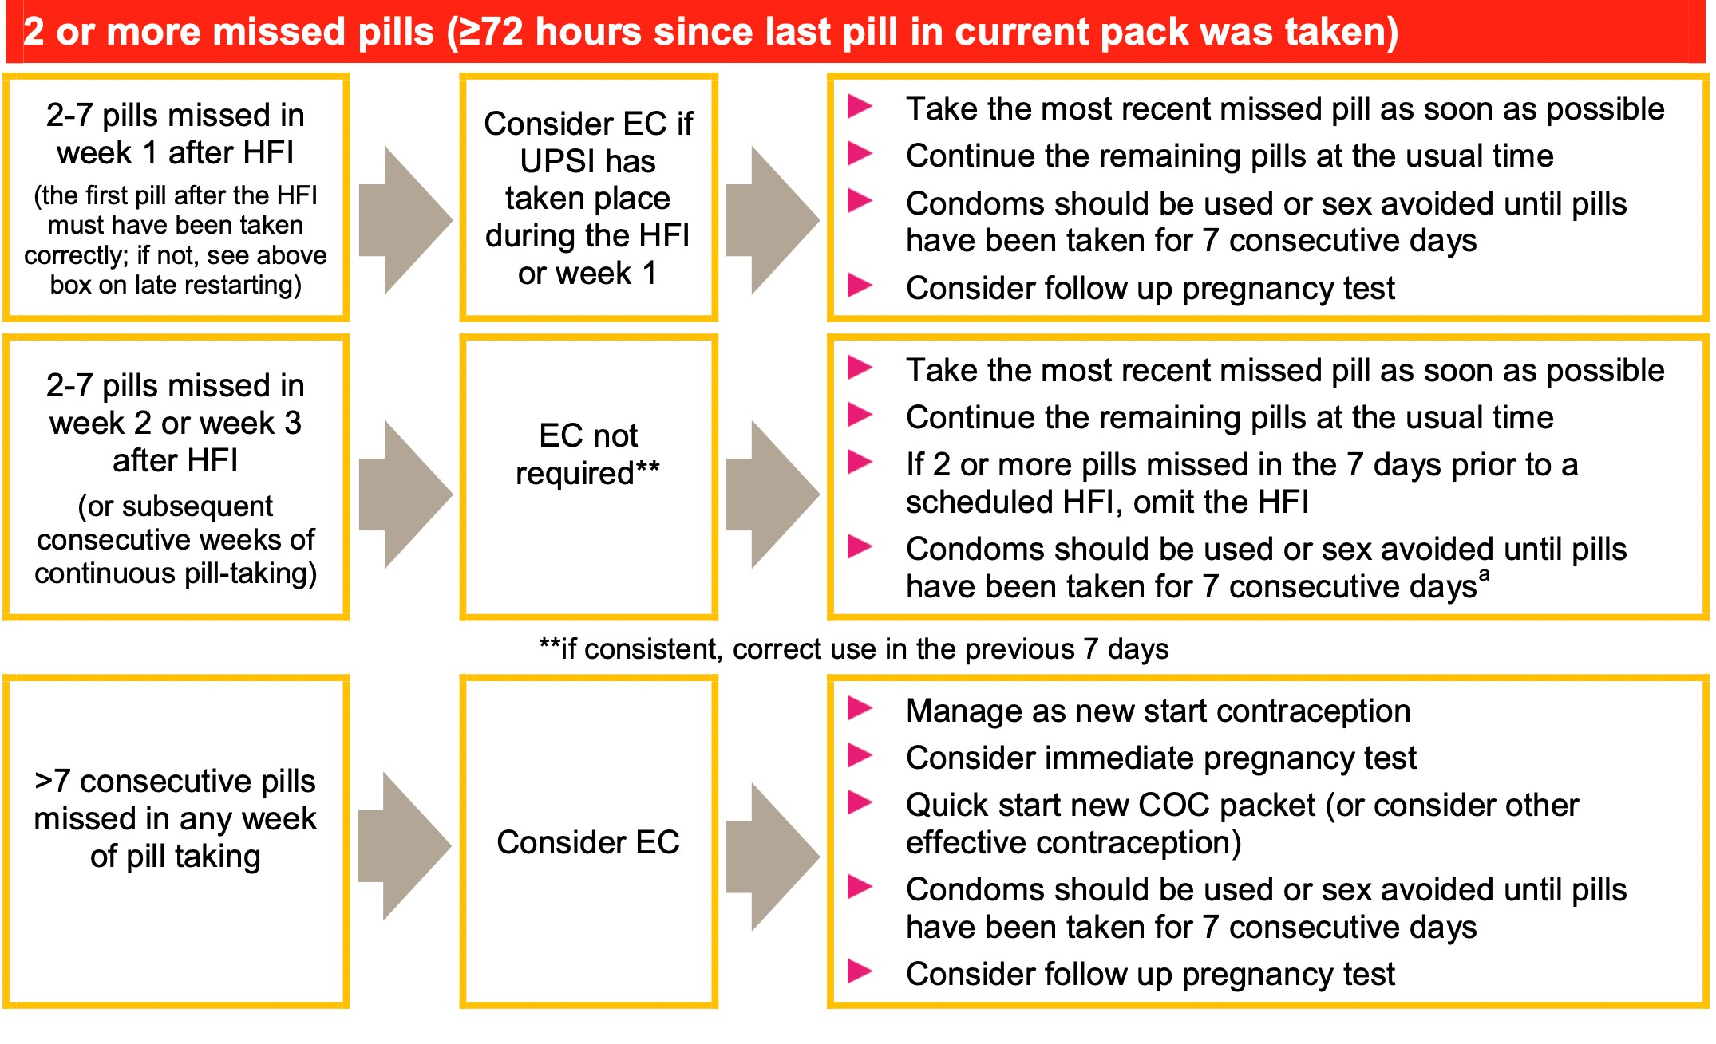
Incorrect use of COC
FSRH guideline:combined hormonal contraception, 2019
20

Slide 21
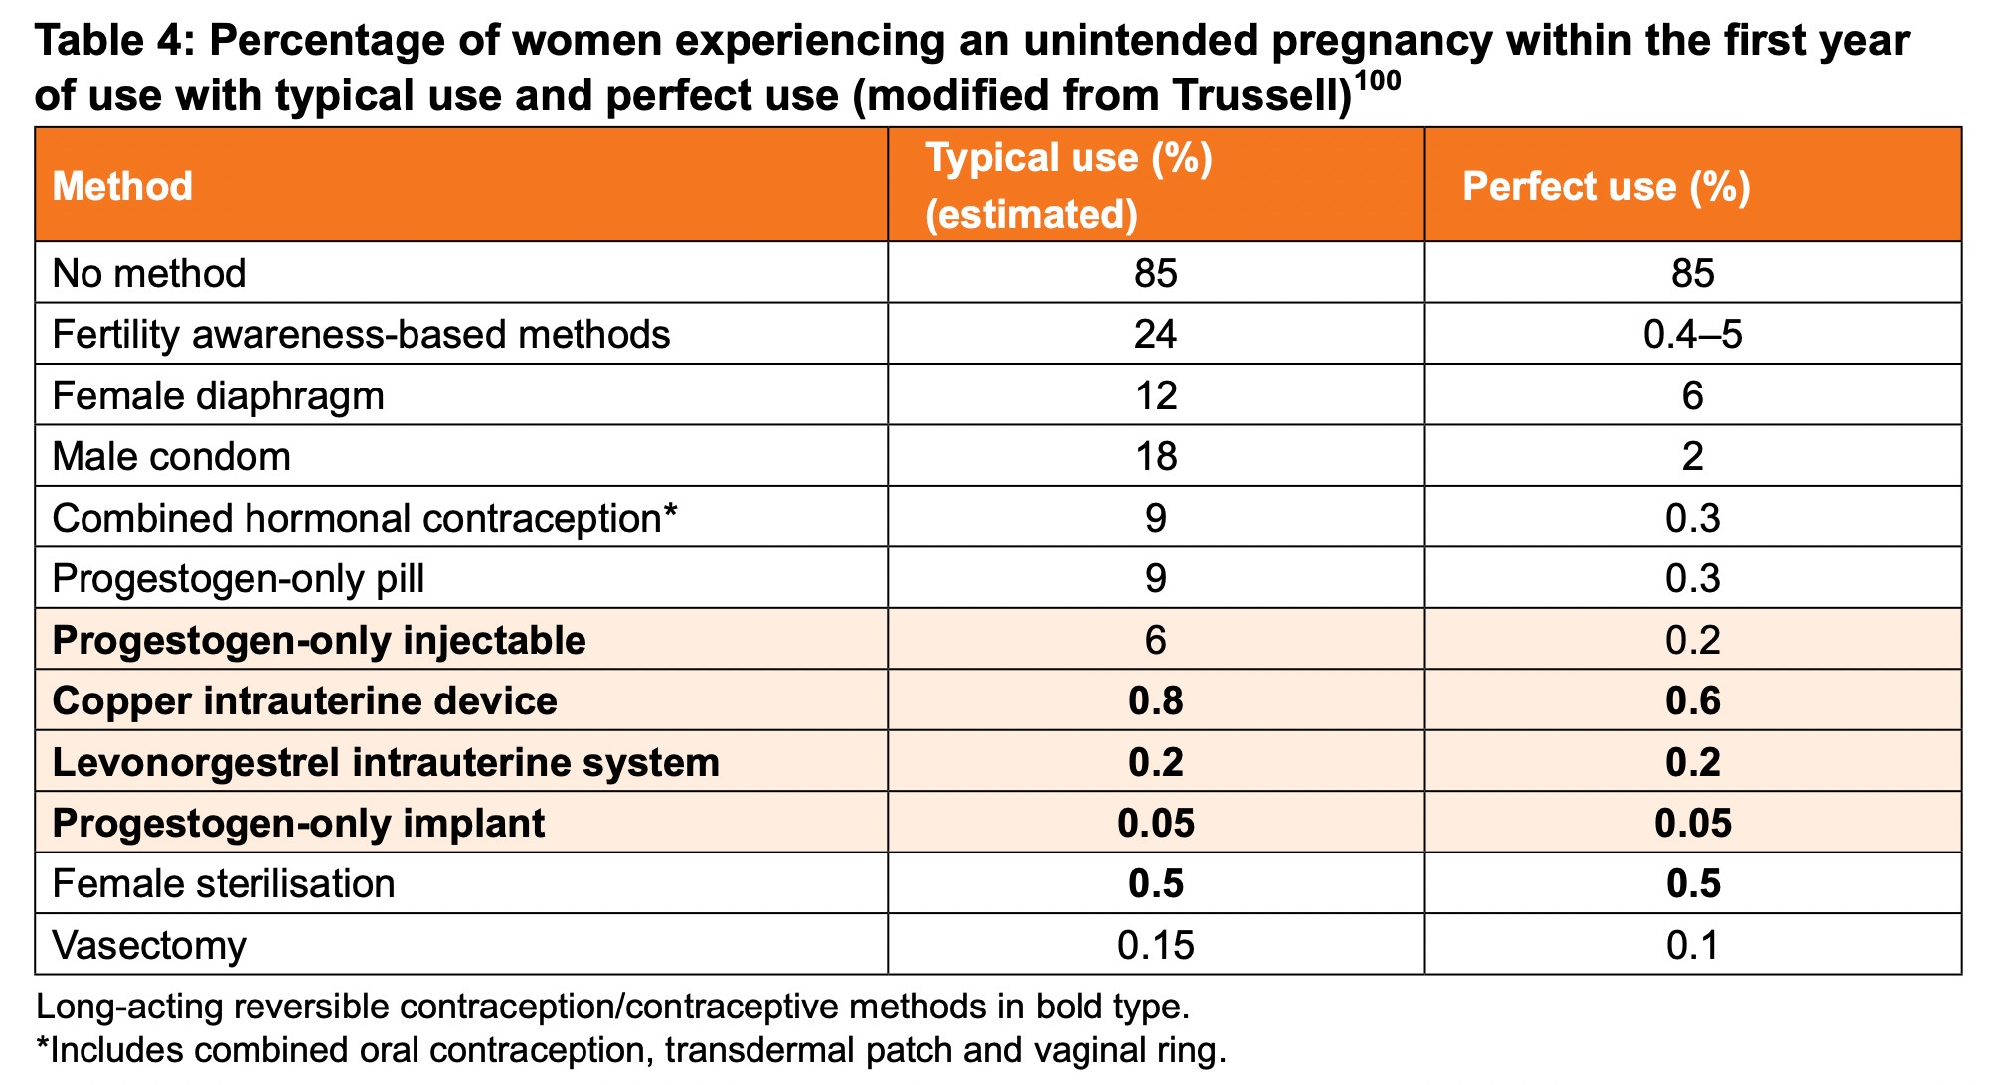
FSRH guideline:combined hormonal contraception, 2019

Slide 22











Non-contraceptive benefit
Heavy menstrual bleeding
Menstrual pain
Endometriosis
Acne
Vasomotor symptoms
PCOS
Premenstrual symptoms
Cancer risk
Endometrial cancer Ovarian cancer Colorectal cancer

Slide 23
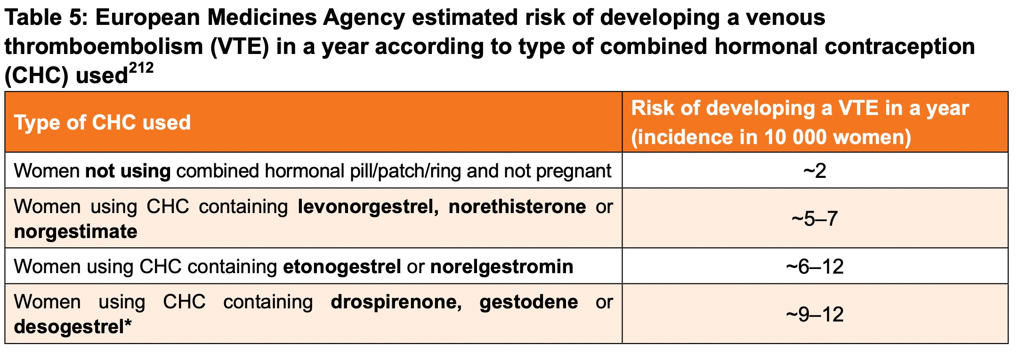
Health risk
Deep vein thrombosis&pulmonary embolism
Small increase absolute risk
The risk depend on progestogen type and estrogen dose
Venous thromboembolism
FSRH guideline:combined hormonal contraception, 2019

Slide 24


Health risk
Ischemic stroke&myocardial infarction
Small increase risk and extremely uncommon
The risk increase with estrogen dose
The risk does not depend on progestogen type
Arterial thromboembolism
A small increase risk of breast cancer
Risk reduces with the time after stopping Family history of breast cancer [UKMEC cat1] BRCA mutation [UKMEC cat3]
Breast cancer

Slide 25

Side effects
Unscheduled bleeding
  % per cycle
Decrease with time and more likely in the first cycle Some show the improvement over the first 3 months
Lower dose of EE is more likely to associated with bleeding
Extended or continuous regimens could offer less unschedule bleeding Trial and error for individual woman may be the best approach
Cautions
    Missed pills
    Pregnancy
    Cervical pathology
    STDs

Slide 26

Side effects
Headache
Headache is frequently reported as a side effect of COC Often associated with hormone-free interval&early cycles
Extended or continuous regimen reduce frequency of headache A reason of discontinuation
Headache also occurs with placebo
Systematic review >> No association between COC and headache

Slide 27




Side effects
Mood
Negative mood change
Offer different formulation progestogen
Premenstrual period >> continuous regimen may be benefit
Libido and weight gain
No clear evidence of an association

Slide 28



Planning pregnancy
There is no significant delay in return to fertility
Conception rates are comparable to those who
stop other contraceptive method or no contraception
Folic acid can be started prior to stoping COC
Fetal exposure to COC is not associated with fetal anomaly

Slide 29






Menopausal transition
COC can be used by eligible women until age of 50
Suppress menopausal symptoms Regulated bleeding
Maintain BMD
During the use of COC FSH and LH are suppress
If HRT is indicated, it can be used with other non-COC method

Slide 30

Thank you
30

