Slide 1
Medical
Diagnostic / Screening
Test

Slide 2
Pretest
In a project of screening Down synd. in 40,000 women with prevalence of 1 / 1000, using the test with sensitivity of 70%, and specificity of 95%, how many invasive procedures will be needed to find 1 Down fetus and how many preocedures are needed in this project?
  ??
  ????

Slide 3
Probability & Odds
Probability Odds
4 / 5 4 : 1
1 / 2 1 : 1
1 / 5 1 : 4
1 / 10 1 : 9
Odds Probability
4 : 1 4 / 5
1 : 2 1 / 3
1 : 5 1 / 6
1 : 10 1 / 11

Slide 4
Bayes Theorem
PPV =
(Sensitivity x Prevalence)
(Sensitivity x Prevalence) + (1-Specificity)(1-Prevalence)
0.8 x 0.002 / (0.8 x 0.002) + ((1-0.8) x (1-0.002))
= 0.007952286

Slide 5
Test | Dis. | No Dis. | Total
+ ve | a | b | a+b
- ve | c | d | c+d
Total | a+c | b+d | a+b+c+d
Sensitivity : a / a+c
Specificity : d / b+d
False positive : b / b+d
PPV : a / a+b
NPV : d / c+d
LR : sensitivity / 1-specificity
OAPR a : b

Slide 6
Test | Dis. | No Dis. | Total
+ ve | a | b | a+b
- ve | c | d | c+d
Total | a+c | b+d | a+b+c+d
Sensitivity : โอกาสที่ test จะ positive ในรายที่เป็นโรค
Specificity : โอกาสที่ test จะ negative ในรายที่ปกติ
False positive : โอกาสที่ test จะ positive ในรายปกติ
PPV : โอกาสที่จะเป็นโรคในรายที่ test positive
NPV : โอกาสที่จะไม่เป็นโรคในรายที่ test negative
LR : เปรียบโอกาสที่ test positive ระหว่างรายที่เป็นโรคและรายปกติ
OAPR : อัตราส่วนของจำนวนผู้เป็นโรคต่อไม่เป็นโรคเมื่อ test positive

Slide 7
Test | Dis. | No Dis. | Total
+ ve | a | b | a+b
- ve | c | d | c+d
Total | a+c | b+d | a+b+c+d
LR : เปรียบโอกาสที่ test positive ระหว่างรายที่เป็นโรคต่อรายปกติ
OAPR : อัตราส่วนของจำนวนผู้เป็นโรคต่อไม่เป็นโรคเมื่อ test positive
Pretest Probability : Prevalence
Pretest Odds : Prevalence / 1-Prevalence
Posttest Odds (OAPR) : Pretest Odds x LR
Posttest Probability (PPV) : Posttest Odds / Posttest Odds +1

Slide 8
Bayes Theorem
PPV = : Posttest Odds / Posttest Odds +1
[(Prev / 1-Prev) x (Sens / 1-Spec)]
[(Prev / 1-Prev) x (Sens / 1-Spec)] +1
[(Prev x Sens) / (1-Prev) x (1-Spec)]
[(Prev x Sens) / (1-Prev) x (1-Spec)] + [(1-Prev) x (1-Spec) / (1-Prev) x (1-Spec)]
(Sensitivity x Prevalence)
(Sensitivity x Prevalence) + (1-Specificity)(1-Prevalence)

Slide 9
 | Down | Normal | Total
hCG +ve | 1.5 | 30 | 31.5
hCG -ve | 0.5 | 968 | 968.5
Total | 2 | 998 | 1000
OAPR (odd of being affected, given a positive result) 1 : 20
PPV (positive predictive value) 1 : 21 (~ 5%)
PPV = (Sens x Prev) / (Sens x Prev) + (1-Spec)(1-Prev)

Slide 10
Question 1
1 What is the chance of a woman with a positive maternal serum hCG result having a fetus with Down syndrome? (hCG: senstivity 75%, specificity 97%, prevalence Down 2:1000)
  25%
  12%
  8%
  5%
  3%

Slide 11
hCG +ve
DR 75%
2 Down
1.5
1000
1 : 20
FPR 3%
998 Normal
30
OAPR = 1 : 20
PPV = 1 : 21 (~ 5%)

Slide 12
Question 2
2 What is the chance of a woman with a positive maternal serum hCG result having a fetus with Down syndrome? (hCG: senstivity 75%, specificity 97%, prevalence Down 1:1000) What would the answer be?
  The same
  Higher
  Lower

Slide 13
hCG +ve
1
DR 75%
0.75
2 Down
1.5
1000
40
1 : 20
999
30
FPR 3%
998 Normal
30
OAPR = 1 : 40
PPV = 1 : 41 (~ 2.5%)

Slide 14
Question 3
3 What is the chance of a woman with a positive maternal serum hCG result having a fetus with Down syndrome? (hCG: senstivity 75%, specificity 97%, prevalence Down 4:1000) What would the answer be?
  The same
  Higher
  Lower

Slide 15
hCG +ve
4
DR 75%
3
2 Down
1.5
1000
10
1 : 20
996
30
FPR 3%
998 Normal
30
OAPR = 1 : 10
PPV = 1 : 11 (~ 10%)

Slide 16
hCG +ve
NT +ve
Down
DR 75%
DR 80%
4
3
1
0.8
4
1000
FPR 3%
FPR 2%
996
30
10
0.2
1
Normal
OAPR = 1 : 10 4 : 1
PPV ~ 10% 4:5 (80%)

Slide 17
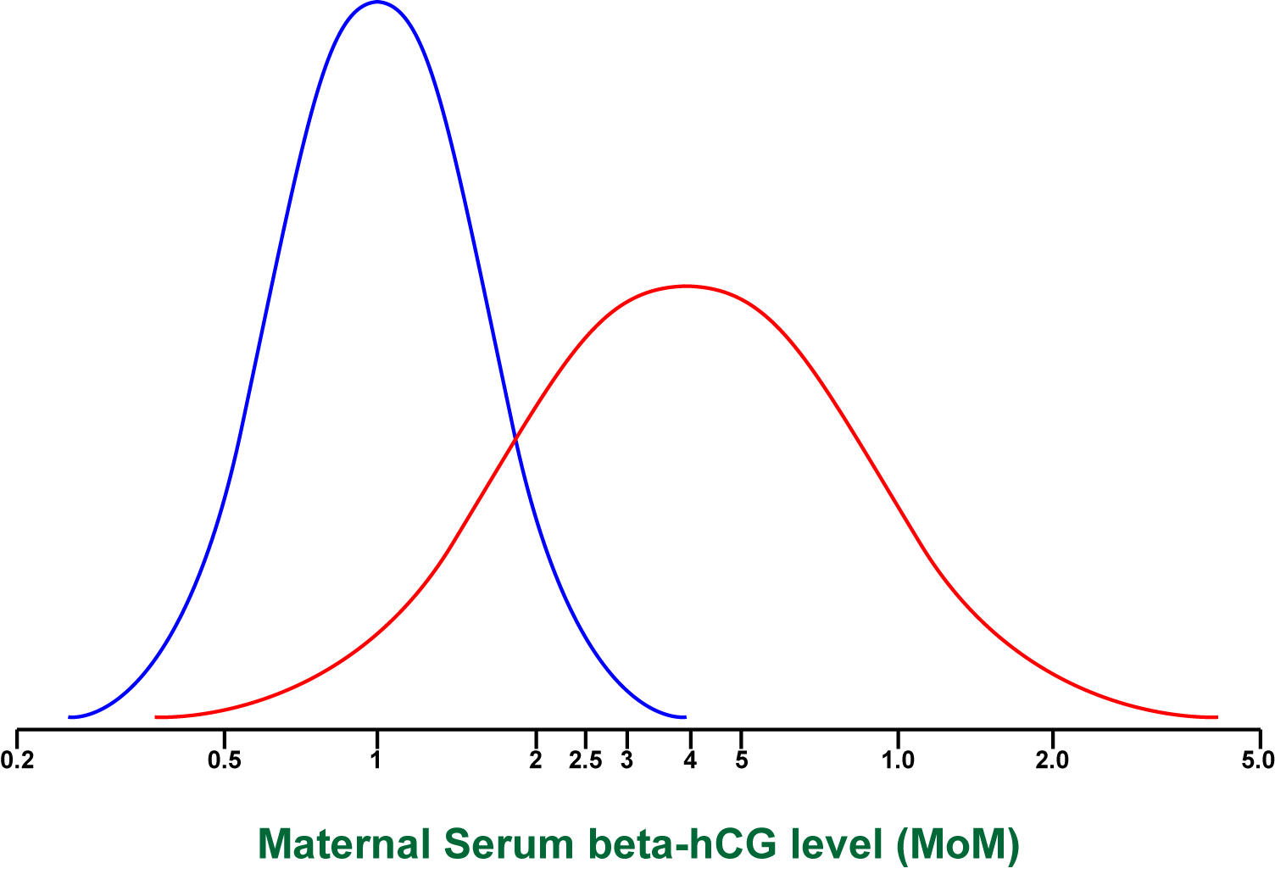
Normal
Down

Slide 18
Multiple of Median (MoM)
Median beta-hCG = 30 IU/ml
• 15 IU/ml: 15/30 = 0.5 MoM
• 30 IU/ml: 30/30 = 1.0 MoM
• 60 IU/ml: 60/30 = 2.0 MoM

Slide 19
What’s different in results??
US markers vs Serum markers
US marker : qualitative
Positive or Negative
Serum marker : quantitative
a cut-off level to separate
Positive or Negative

Slide 20
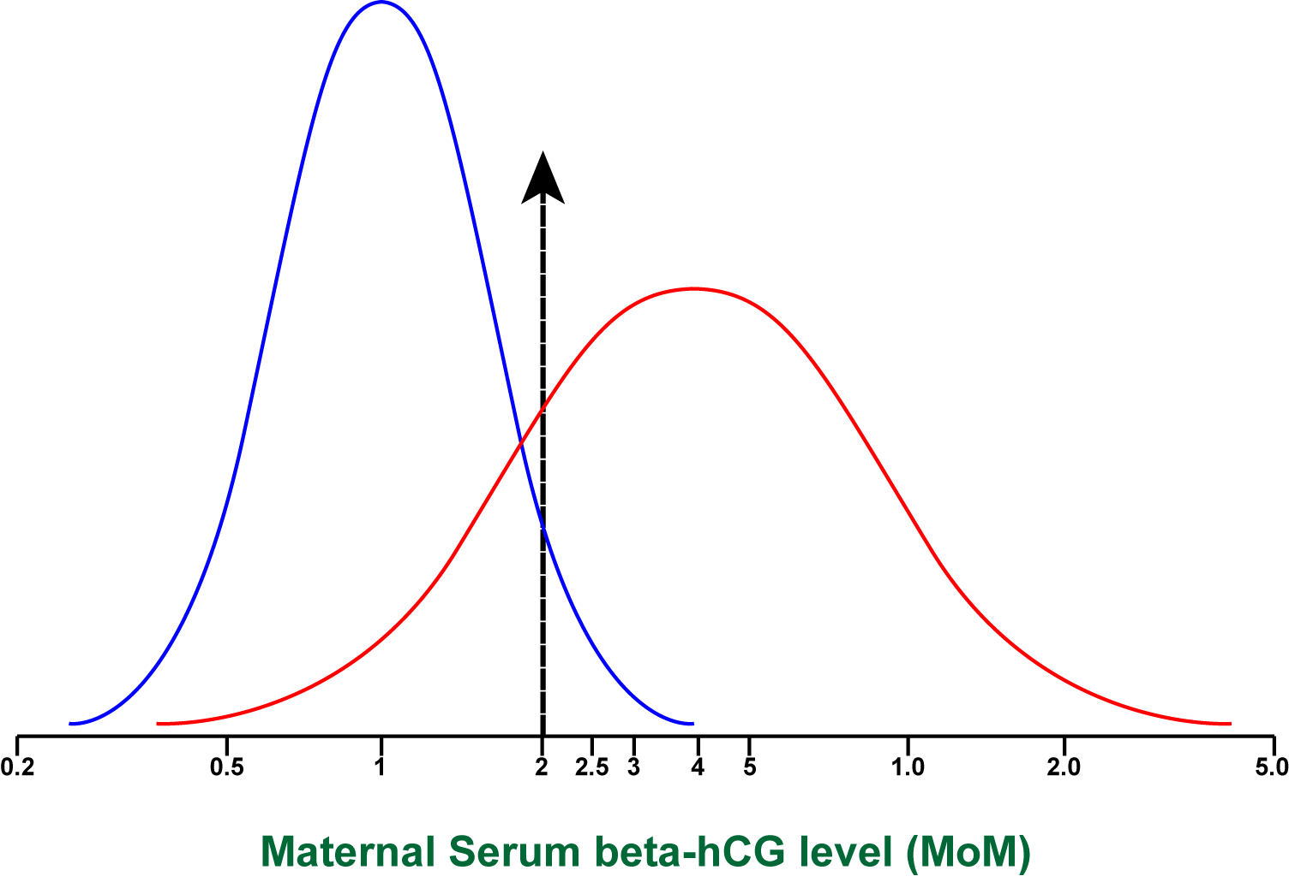

Slide 21


Slide 22


Slide 23
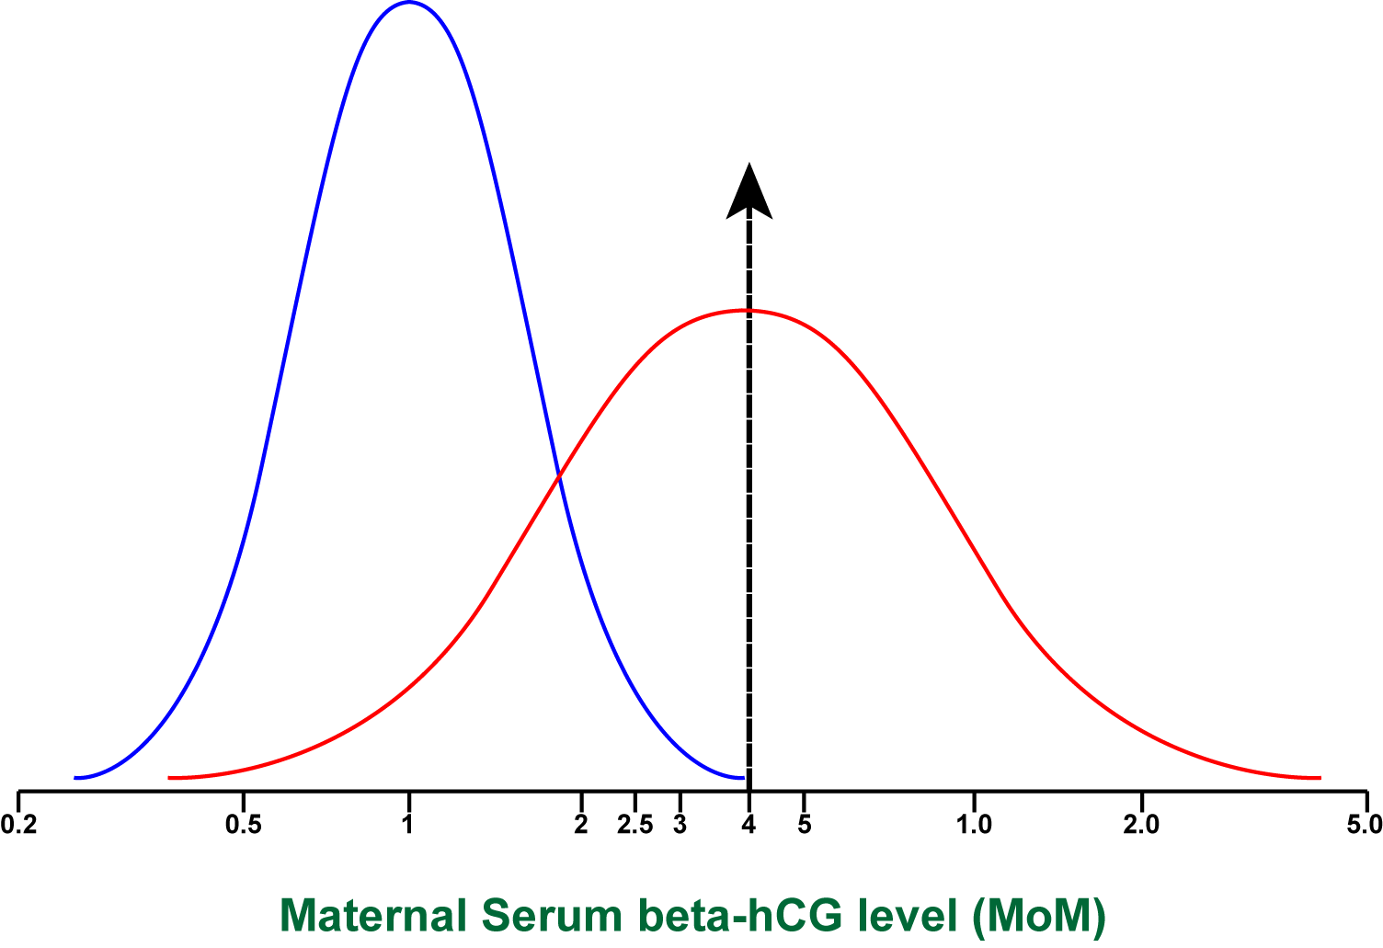

Slide 24
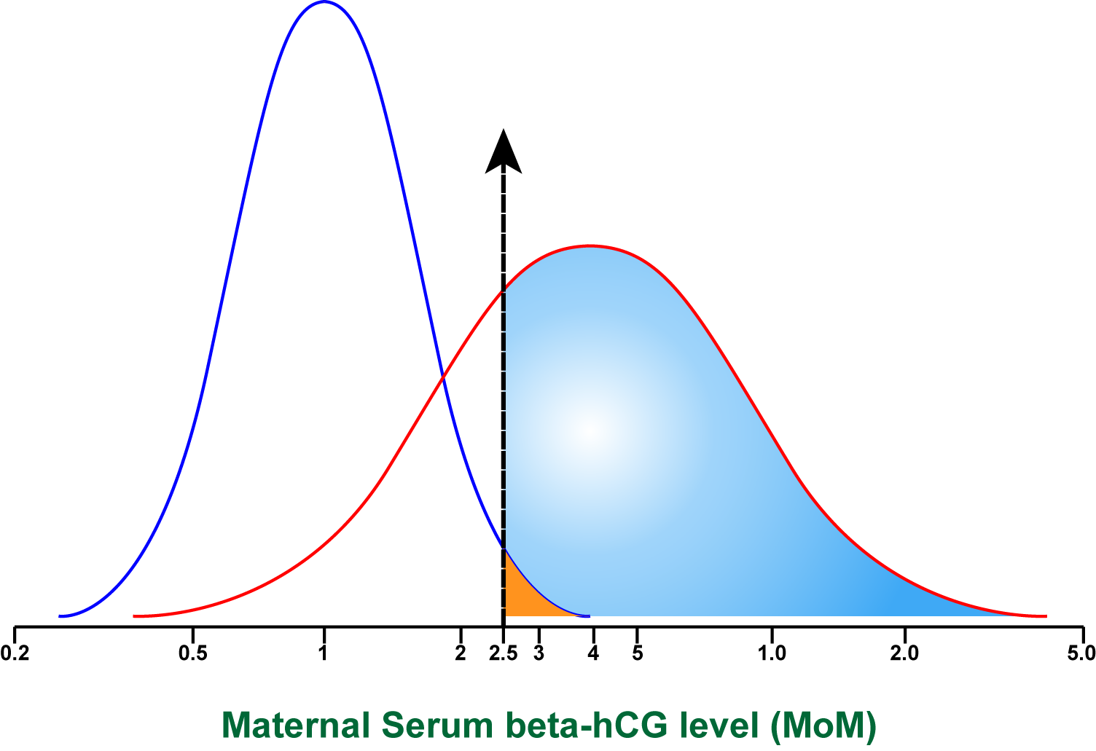
DR 75%
FPR 3%

Slide 25
LR = DR / FPR = 75/3 = 25
OAPR = LR x prevalence as an odds
= 25 x 2/1000 = 1:20
DR 75%
FPR 3%

Slide 26
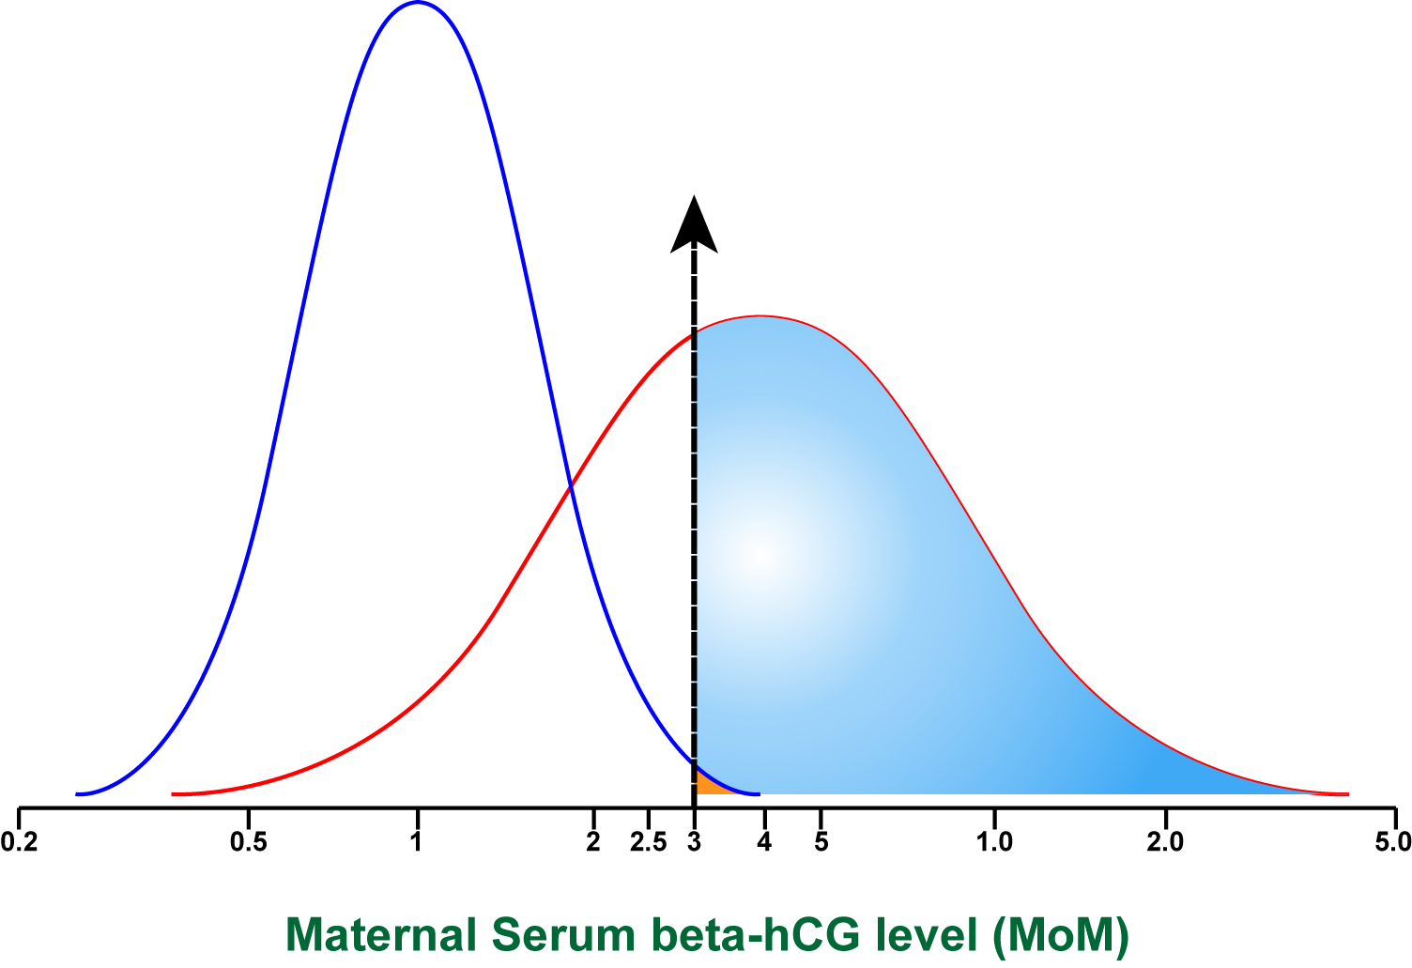
LR = DR / FPR = 65/1 = 65
OAPR = LR x prevalence as an odds
= 65 x 2/1000 = 1:8
DR 65%
FPR 1%

Slide 27
Question 5
5 What is the test specific risk for an individual woman with an serum hCG of 2.5 MoM?
Based on specific graph hCG: senstivity 80 %, specificity 80%, instead of 75% & 97% respecitively
Prevalence Down 2:1000
  1%
  3 %
  5 %
  8%
  25%

Slide 28
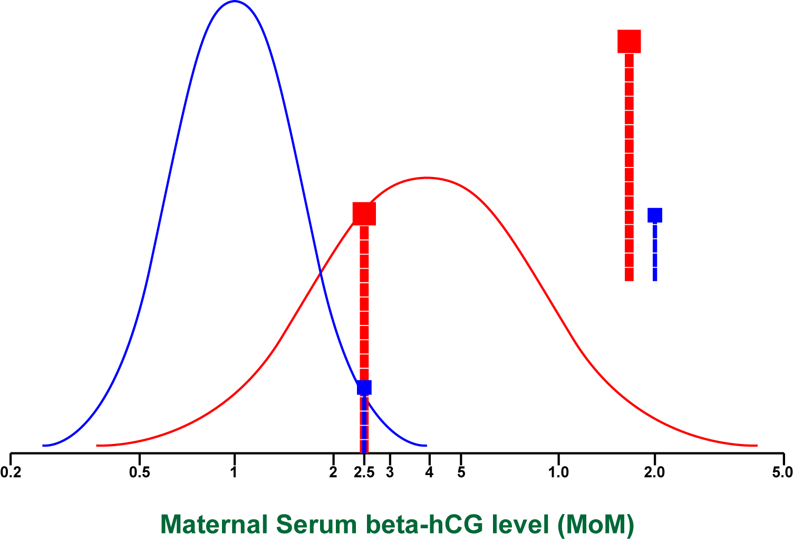
LR = 8 / 2 = 4
Risk = 8/1000
8%
2%

Slide 29
Question 6
6 If a woman is told that her risk of having a Down fetus is quite ‘normal’, that is, the risk is no higher and no lower than the risk for women in general, what is her hCG level?

Slide 30

LR = 1 / 1 = 1
Risk = 2/1000
1.8 MoM

Slide 31
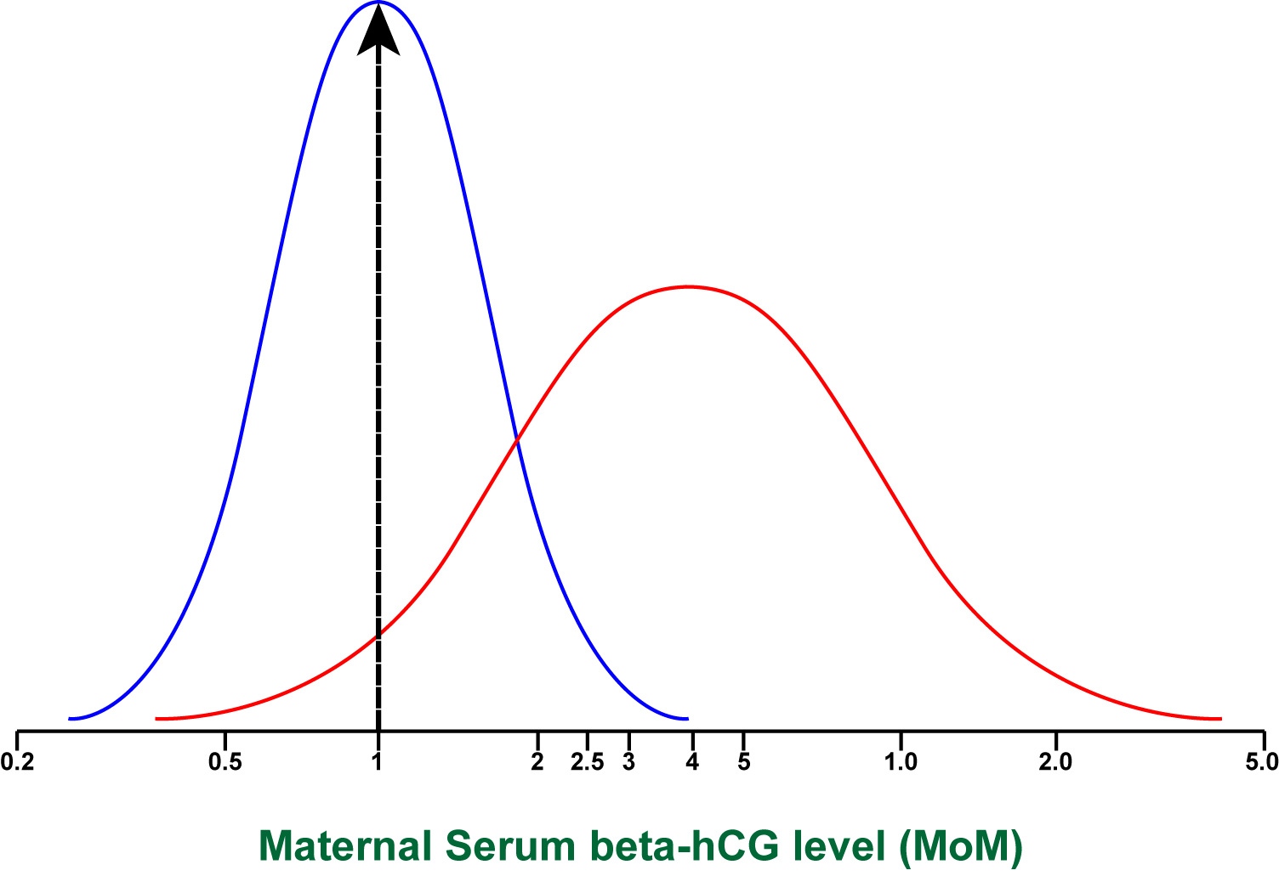
LR = 1 / 10 = 0.1
Risk = 2/10,000 = 1/5,000
1.0 MoM

Slide 32
Critical Indices for Screening Test
1. Detection Rate (sensitivity) (DR)
Proportion of affected individuals with positive results
2. False Positive Rate (1-specificity) (FPR)
Proportion of unaffected individuals with positive results
3. Odds of being affected given a positive result (OAPR)
True positives : False positives

Slide 33
Question 7
In a project of screening Down synd. in 40,000 women with prevalence of 1 / 1000, using the test with sensitivity of 70%, and specificity of 95%, how many invasive procedures will be needed to find 1 Down fetus and how many preocedures are needed in this project?
  71 procedures
  2000 procedures to detect 28 Down fetuses

