Slide 1


Cerebellar and Vermis
malformations

Slide 2
Cerebellar and Vermis malformations
Cystic and cyst-like Abnormalities of posterior fossa
Routine fetal sonography
  Normal cisterna magna (AP : 2 - 10 mm)
  Ventricular atrium (< 10 mm)
High negative predictive value (P < 0.005%)
Antenatal studies
  Difﬁcult to extremely difﬁcult evaluation
  Extremely cautious in making diagnosis
  Combine US and MRI : consistent with postnatal Dx in 90%
Ashley J. R. The Fetal Cerebellar Vermis Assessment for Abnormal Development by Ultrasonography and Magnetic Resonance Imaging.
Ultrasound Quarterly 2007;23:211Y223

Slide 3
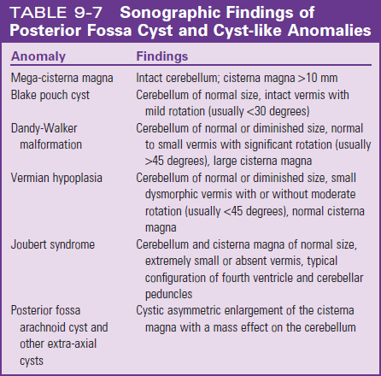
Callen's Ultrasonography in Obstetrics and Gynecology, 6th edition

Slide 4
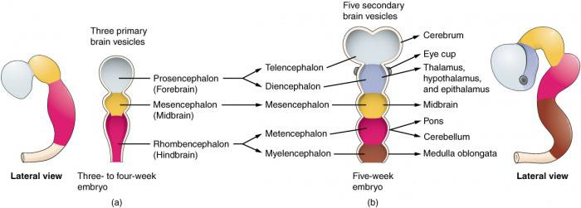
Development of cerebellar and vermis
Callen's Ultrasonography in Obstetrics and Gynecology, 6th edition

Slide 5
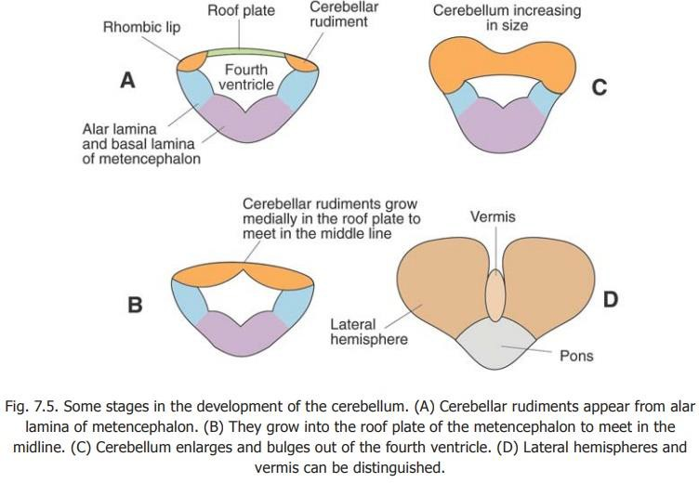
GA | Development
5 weeks | Starts development as a thickening of alar plate of rhombencephalon
10 to 11 weeks | vermis enlarges rostrally, and hemispheres enlarge laterally.
18 to 19 weeks | Fourth ventricle is usually completely covered
Ashley J. R. The Fetal Cerebellar Vermis Assessment for Abnormal Development by Ultrasonography and Magnetic Resonance Imaging. Ultrasound Quarterly 2007;23:211Y223

Slide 6
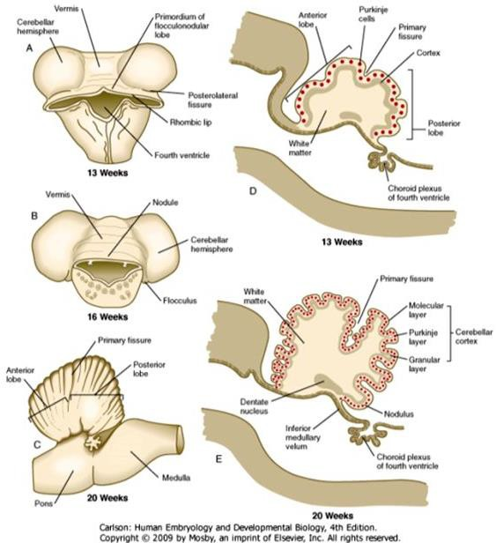
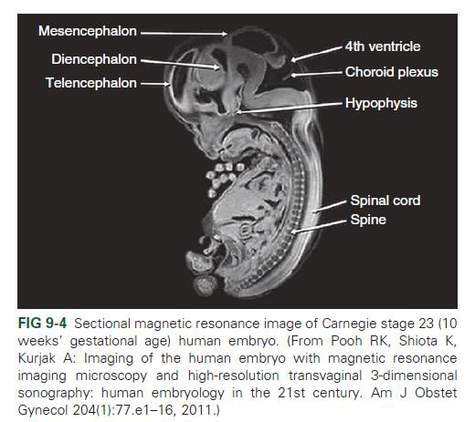
Callen's Ultrasonography in Obstetrics and Gynecology, 6th edition

Slide 7
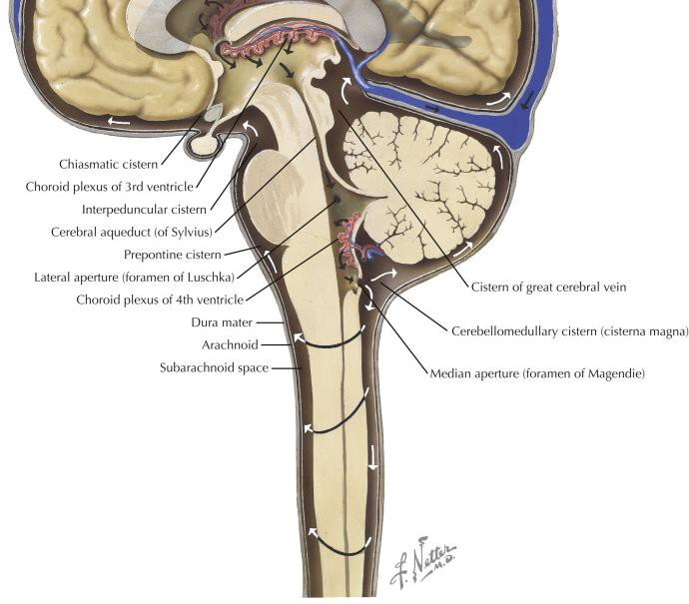

Slide 8
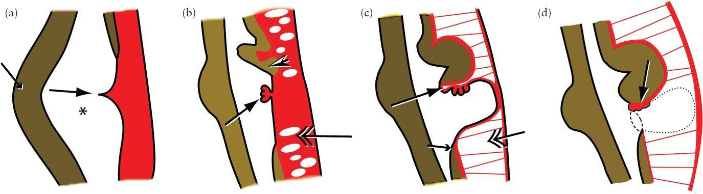
Fourth ventricle–Blake pouch complex
During formation of the dorsal pontine flexure (small arrow) a transverse crease (large arrow) forms in the roof of the rhombencephalic vesicle ( ), dividing it into anterior (cranial) and posterior (caudal) membranous areas.
The vermis (arrowhead) develops from the rhombic lip at the superior margin of the anterior membranous area. Choroid plexus develops in the crease (arrow). Cavitation starts in the overlying meninx primitiva (double arrow) to form the subarachnoid space.
As the cerebellum grows inferiorly the posterior membranous area bulges out between the vermis (large arrow) and the nucleus gracilis (small arrow), forming Blake's pouch. The subarachnoid space remains trabeculated by pia‐arachnoid septations (double arrow).
Blake's pouch fenestrates (dotted line) and the neck of Blake's pouch becomes the foramen of Magendie (dashed line). The choroid plexus (arrow) now appears to be in the cisterna magna.
ASHLEY J. R. Inferior vermian hypoplasia –preconception, misconception. Ultrasound Obstet Gynecol 2014; 43: 123–136

Slide 9
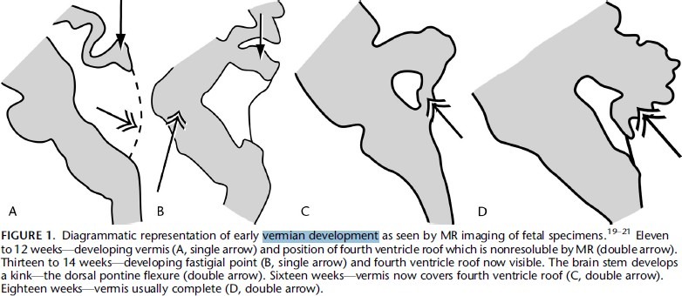
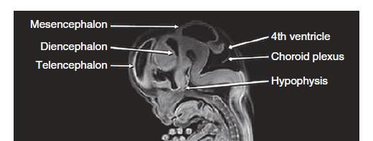
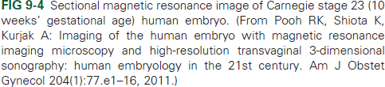
11 – 12 weeks
13 – 14 weeks
16 weeks
18 weeks
Ashley J. R. The Fetal Cerebellar Vermis Assessment for Abnormal Development by Ultrasonography and Magnetic Resonance Imaging.
Ultrasound Quarterly 2007;23:211Y223

Slide 10
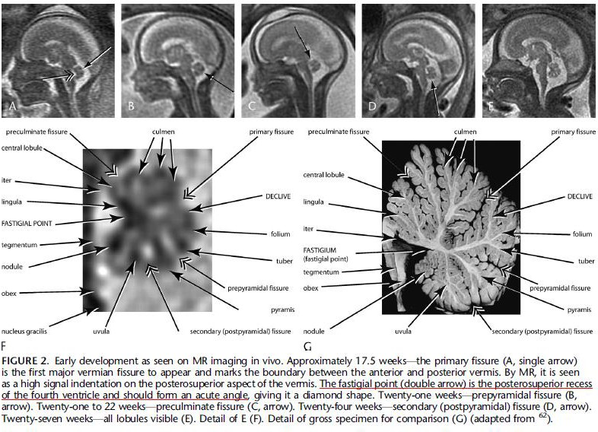
17.5 weeks
Ashley J. R. The Fetal Cerebellar Vermis Assessment for Abnormal Development by Ultrasonography and Magnetic Resonance Imaging.
Ultrasound Quarterly 2007;23:211Y223

Slide 11
Ultrasonographic evaluation
Should include multiplanar images of cerebellum
Axial plane
  Transcerebellar diameter
  Fourth ventricle size
  Cerebellar peduncles thickness
Coronal plane
  Enables differentiation between cerebellar hemispheres & vermis
Midsagittal plane
  Most important plane
  Depiction of vermian lobules, fissures and shape of fastigium
  Measurements of vermian diameter
  Ratio superior and inferior vermis ration
  Evaluation of size and shape of pons, cisterna magna and tentorium
Gustavo M. The fetal cerebellum. Pitfalls in diagnosis and management. Prenat Diagn 2009; 29: 372–380.

Slide 12
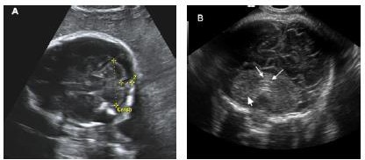
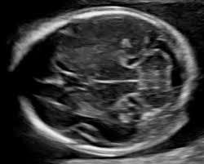
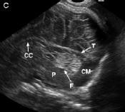
Gustavo M. The fetal cerebellum. Pitfalls in diagnosis and management. Prenat Diagn 2009; 29: 372–380.

Slide 13
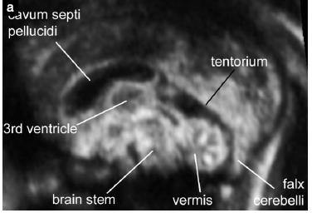
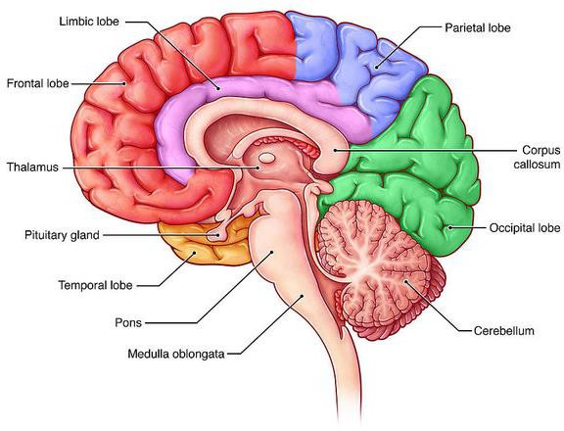
Midsagittal plane
VOLPE P. Brainstem–vermis and brainstem–tentorium angles allow accurate categorization of fetal upward rotation of cerebellar vermis.
Ultrasound Obstet Gynecol 2012; 39: 632–635

Slide 14
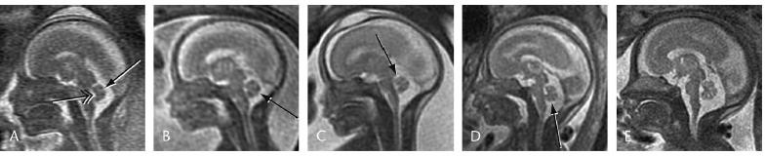
Fetal magnetic resonance imaging
Useful in difficult cases
  Orthogonal views are more readily obtainable
  Other limitations of ultrasonography
    Maternal obesity
    Fetal skull ossification
    Oligohydramnios
Ashley J. R. The Fetal Cerebellar Vermis Assessment for Abnormal Development by Ultrasonography and Magnetic Resonance Imaging.
Ultrasound Quarterly 2007;23:211Y223

Slide 15
Posterior fossa cyst or cyst like anomalies
Dandy-Walker Continuum
Normal outcomes or can be syndromic with poor outcomes
  Based on the degree of vermian hypoplasia/dysplasia
  Presence of associated abnormalities
    Structure, chromosome, or genetic
Blake pouch cyst
Mega cisterna magna
Dandy-Walker malformatiom (DWM)
Dandy-Walker variant(DWV)
Inferior vermian hypoplasia syndromes (IVH)
Joubert syndrome
Posterior fossa arachnoid cyst

Slide 16
Blake pouch cyst
Isolated persistence of Blake pouch
Risk factor for anatomic and chromosomal anomalies
Finding
  Posterior fossa cyst ➔ displaced cerebellar vermis superiorly
  Intact vermis with mild rotation (usually < 30 degrees)
  Normal sign of cerebellar
Mega-cisterna magna
Cisterna magna > 10 mm. in AP dimeter
a variation of Blake pouch cyst
No result in superior displacement of vermis

Slide 17
Blake pouch cyst and mega-cisterna
Two most common
Clinical similarities when isolated
50% of all cystic anomalies of fetal posterior fossa
1/3 : spontaneous resolution during gestation
90% : result in normal postnatal neurodevelopment
Poor correlation of ultrasound and autopsy ﬁndings
  Because postmortem cyst deﬂates
  vermis derotates back into a normal position
ASHLEY J. R. Inferior vermian hypoplasia –preconception, misconception. Ultrasound Obstet Gynecol 2014; 43: 123–136

Slide 18
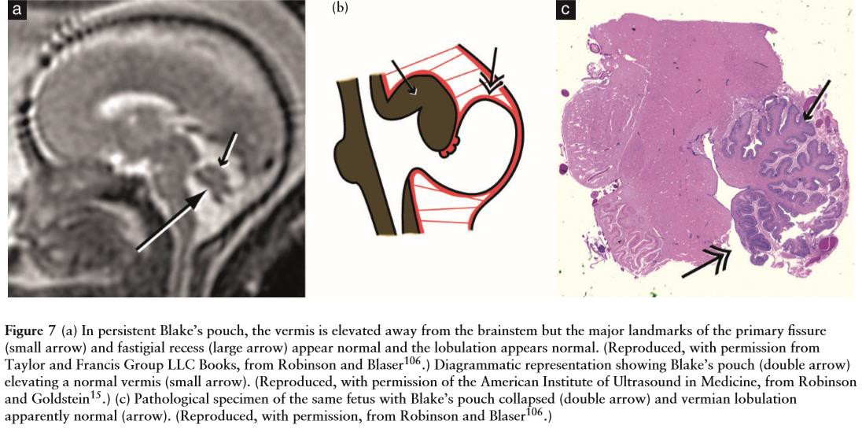
ASHLEY J. R. Inferior vermian hypoplasia –preconception, misconception. Ultrasound Obstet Gynecol 2014; 43: 123–136

Slide 19
Dandy-Walker malformation(DWM)
Classic Dandy-Walker malformation
Classic triad
  Hypoplasia of vermis and superior displacement
  Enlargement of posterior fossa
  Cystic dilation of 4th ventricle extending posteriorly
Some authors also include hydrocephalus
  Frequent complication
  Not usually present at birth
Recurrence risk ➔ Associated with
  Single gene disorders : Warburg & Meckel-Gruber syndromes
  Chromosomal abnormalities

Slide 20

Classic Dandy–Walker malformation
Two processes to occur together
  Vermian development ➔ no cover 4th ventricle
  Failure of adequate fenestration of 4th ventricular outﬂow
foramina
    Enlarged Blake’s pouch
    Secondary elevation and compression of vermis
Dandy–Walker variant
Vermian hypoplasia but without other features of classic triad

Slide 21
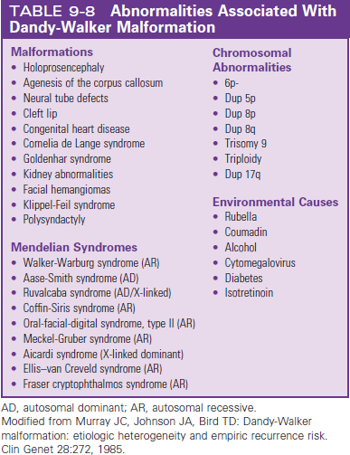
Callen's Ultrasonography in Obstetrics and Gynecology, 6th edition

Slide 22
Inferior vermian hypoplasia
Alternative to nomenclature ‘Dandy–Walker variant’
Vermis grows in a superior-to-inferior direction
Partial agenesis involves its inferior part
Appears before 18 weeks
Also occur if a destructive episode damages
➔Allowing lobules that appear later to develop normally
➔Fetal alcohol syndrome
➔No affecting subsequent development
ASHLEY J. R. Inferior vermian hypoplasia –preconception, misconception. Ultrasound Obstet Gynecol 2014; 43: 123–136 Gustavo M. The fetal cerebellum. Pitfalls in diagnosis and management. Prenat Diagn 2009; 29: 372–380.

Slide 23
Joubert syndrome
Autosomal recessive
Congenital malformation of brainstem and agenesis or hypoplasia of cerebellar vermis
  Abnormally deep interpeduncular fossa
  Elongated superior cerebellar peduncles
  Hypoplastic cerebellar vermis
Molar or wisdom tooth sign
Abnormal respiratory pattern, nystagmus, hypotonia, ataxia and delay development
Callen's Ultrasonography in Obstetrics and Gynecology, 6th edition

Slide 24
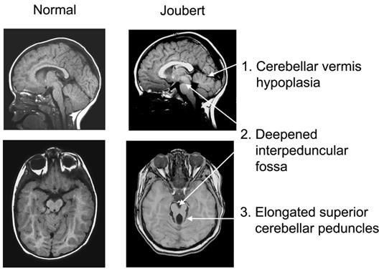

Slide 25
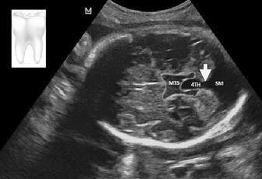
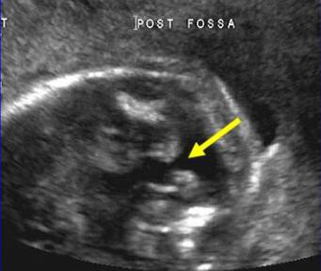
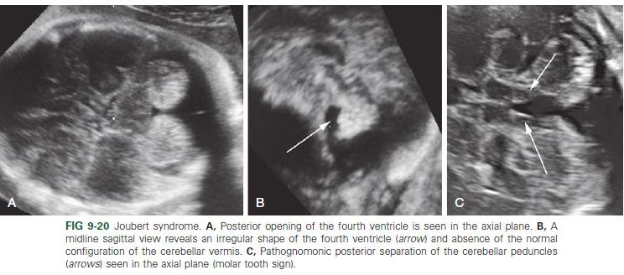
Callen's Ultrasonography in Obstetrics and Gynecology, 6th edition

Slide 26
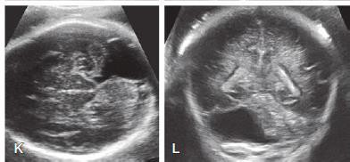
Arachnoid cysts
Rare condition
Difficult to differentiate from mega-cisterna or DWM
DDx of cystic lesions of posterior fossa
Asymmetric enlarge enlargement of cisterna magna
Mass effect on cerebellar structures
Callen's Ultrasonography in Obstetrics and Gynecology, 6th edition

Slide 27
Objective approach
Brainstem–vermis (BV) angle (tegmento-vermian angle )
Brainstem–tentorium (BT) angle
Craniocaudal Diameter of vermis
Ratio of superior and inferior lobes of vermis
Transcerebellar diameter

Slide 28
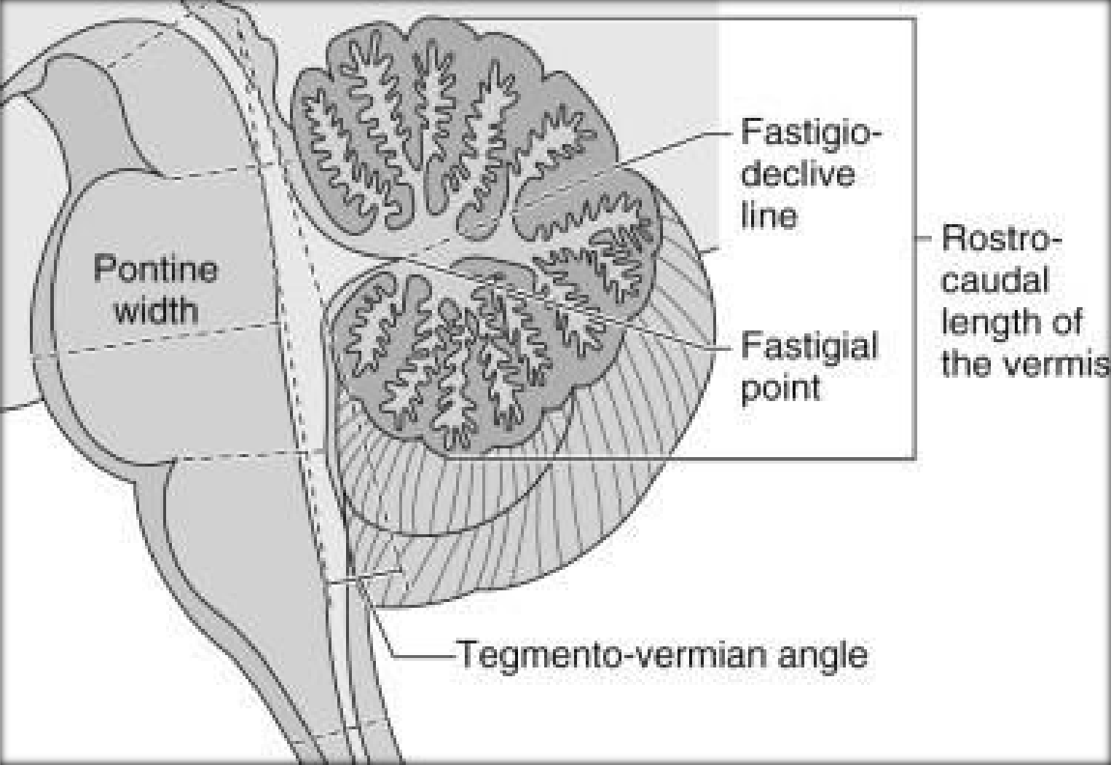
Brainstem–vermis (BV) angle
(tegmento-vermian angle )

Slide 29
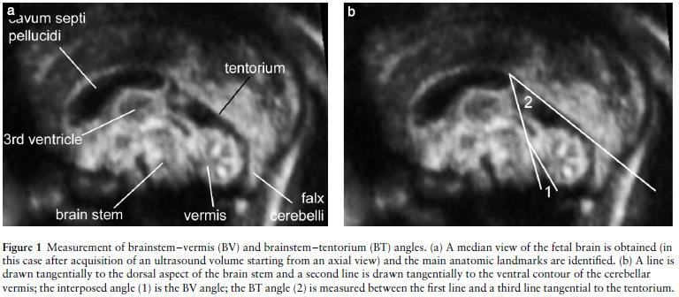
Brainstem–vermis (BV) angle Brainstem–tentorium (BT) angle
Measurements : median views ➔ Tangential line
  Dorsal aspect of brain stem
  Ventral contour of cerebellar vermis
  Tentorium
VOLPE P. Brainstem–vermis and brainstem–tentorium angles allow accurate categorization of fetal upward rotation of cerebellar vermis. Ultrasound Obstet Gynecol 2012; 39: 632–635

Slide 30
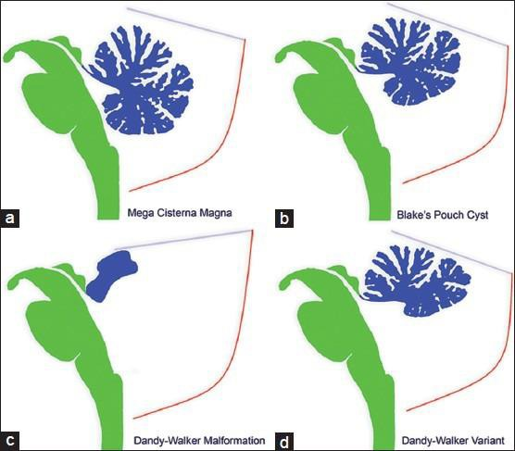

Slide 31
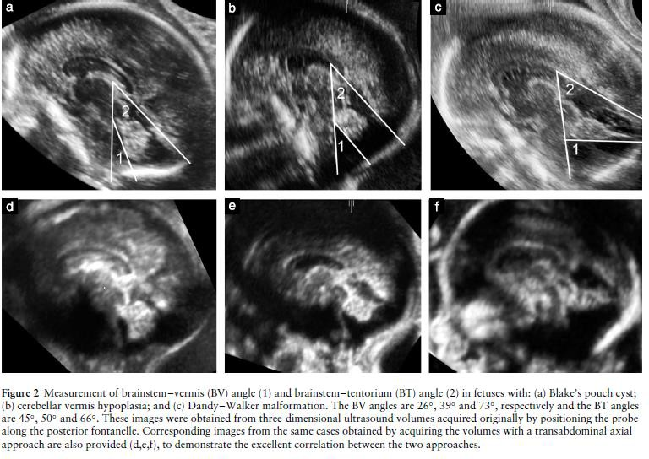
VOLPE P. Brainstem–vermis and brainstem–tentorium angles allow accurate categorization of fetal upward rotation of cerebellar vermis. Ultrasound Obstet Gynecol 2012; 39: 632–635

Slide 32
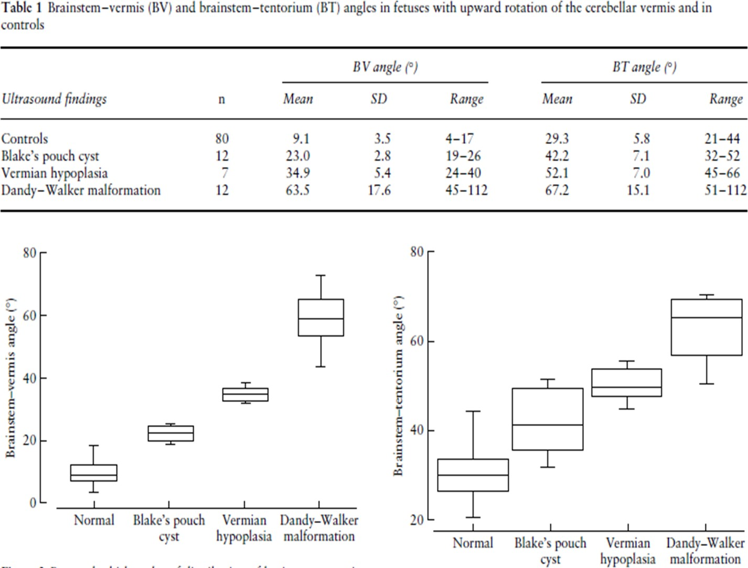
VOLPE P. Brainstem–vermis and brainstem–tentorium angles allow accurate categorization of fetal upward rotation of cerebellar vermis. Ultrasound Obstet Gynecol 2012; 39: 632–635

Slide 33
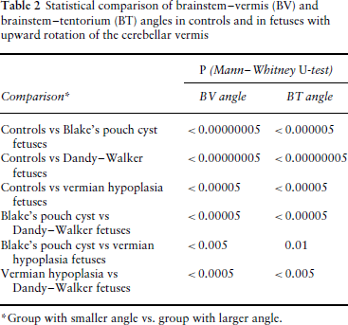
VOLPE P. Brainstem–vermis and brainstem–tentorium angles allow accurate categorization of fetal upward rotation of cerebellar vermis. Ultrasound Obstet Gynecol 2012; 39: 632–635

Slide 34
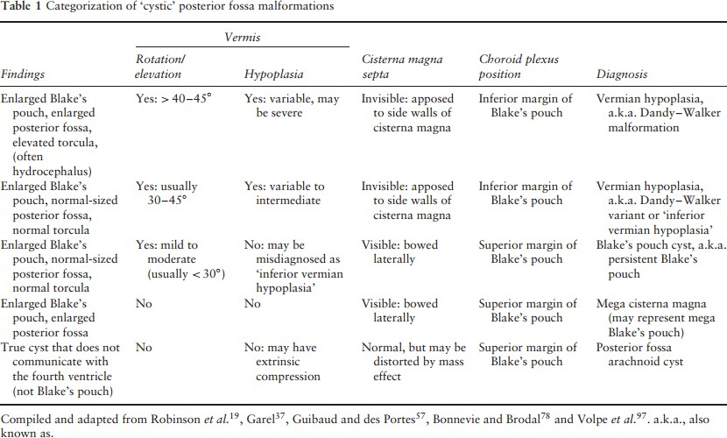
ASHLEY J. R. Inferior vermian hypoplasia –preconception, misconception. Ultrasound Obstet Gynecol 2014; 43: 123–136

Slide 35
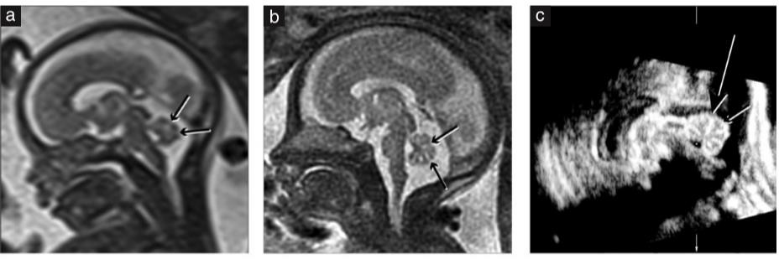
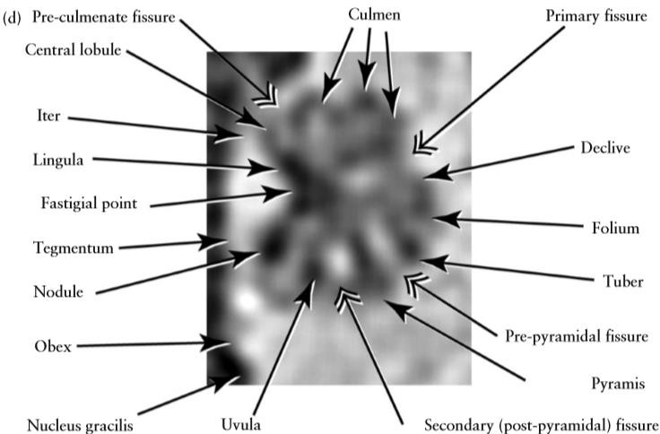
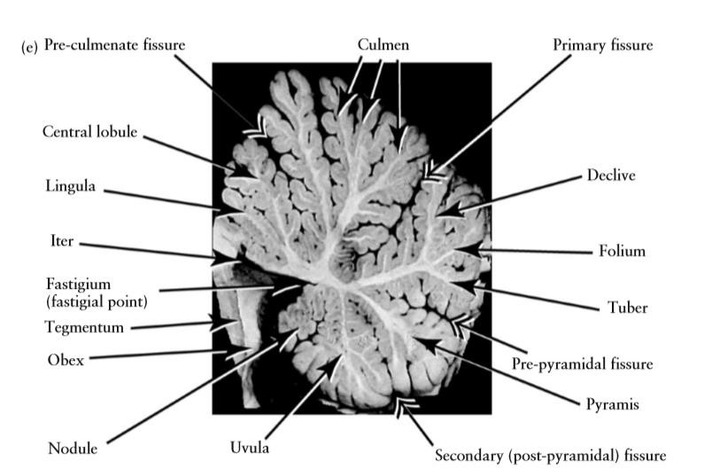
Craniocaudal Diameter of Vermis
Ratio of superior and inferior lobes of Vermis
Ashley J. R. The Fetal Cerebellar Vermis Assessment for Abnormal Development by Ultrasonography and Magnetic Resonance Imaging. Ultrasound Quarterly 2007;23:211Y223

Slide 36
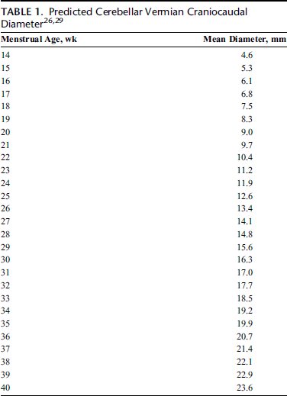
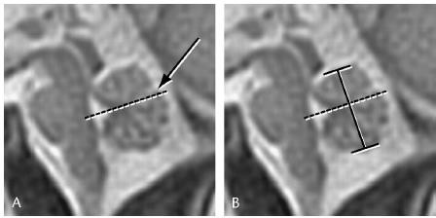

Craniocaudal Diameter of Vermis
Confirmed by US or MRI
Ashley J. R. The Fetal Cerebellar Vermis Assessment for Abnormal Development by Ultrasonography and Magnetic Resonance Imaging. Ultrasound Quarterly 2007;23:211Y223

Slide 37
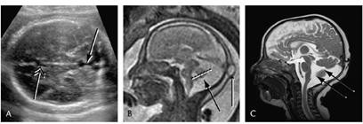

Ratio of superior and inferior lobes of Vermis
Useful in cases of suspected IVH
Reduced relative growth of the inferior vermis
Average ➔ Superior : Inferior = 47% : 53% (1 : 2) ??
No significant change with gestational age
Gustavo M. The fetal cerebellum. Pitfalls in diagnosis and management. Prenat Diagn 2009; 29: 372–380.
Ashley J. R. The Fetal Cerebellar Vermis Assessment for Abnormal Development by Ultrasonography and Magnetic Resonance Imaging. Ultrasound Quarterly 2007;23:211Y223

Slide 38
Pitfalls in Diagnosis & Management
Five different situations may result in diagnostic and counseling errors confusion
  Different entities describing vermian pathologies
  Premature diagnosis of abnormal vermian formation
  Difficulties in the ultrasonographic differentiation between cerebellar hemispheres and vermis
  Late development of cerebellar hypoplasia/atrophy
  Differential diagnosis of unilateral cerebellar findings.
Gustavo M. The fetal cerebellum. Pitfalls in diagnosis and management. Prenat Diagn 2009; 29: 372–380.

Slide 39
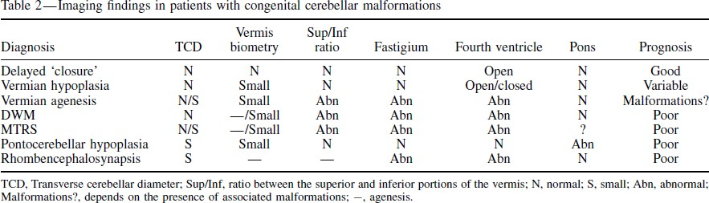
Different entities describing vermian pathologies
Delayed closure of vermis
Vermian hypoplasia
Vermian agenesis
Deﬁnition should be made based on
- Morphological criteria
- Abnormal vermian biometry
Gustavo M. The fetal cerebellum. Pitfalls in diagnosis and management. Prenat Diagn 2009; 29: 372–380.

Slide 40
PREMATURE DIAGNOSIS OF ABNORMAL VERMIAN FORMATION
Should finish development at around 18 weeks
Use of MRI and US ➔ recommended caution in diagnosis at least before 18 weeks of pregnancy
Should not be diagnosis
  DWV : before GA 18 weeks.
  Vermian hypoplasia : before GA 24 weeks
In some cases, vermis does not ‘close’ in utero
  32% diagnosed with IVH in utero ➔ normal postnatal MRI
Gustavo M. The fetal cerebellum. Pitfalls in diagnosis and management. Prenat Diagn 2009; 29: 372–380.

Slide 41
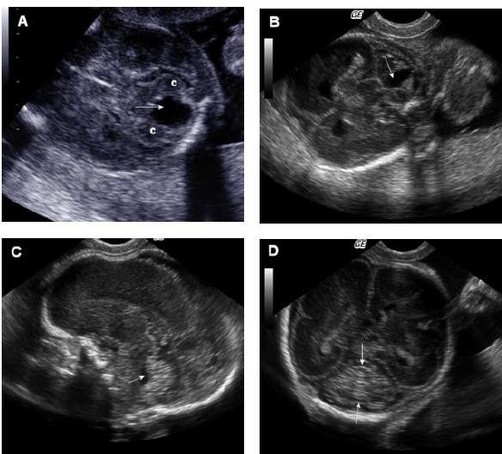
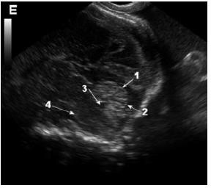

15wk
19wk
28wk
24wk
24wk
Gustavo M. The fetal cerebellum. Pitfalls in diagnosis and management. Prenat Diagn 2009; 29: 372–380.

Slide 42
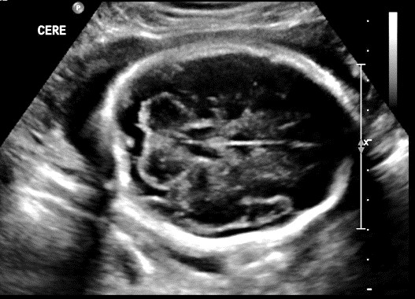
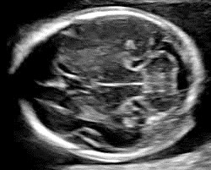
DIFFICULTIES IN ULTRASONOGRAPHIC DIFFERENTIATION BETWEEN CEREBELLAR HEMISPHERES AND VERMIS
Cerebellar | Hemispheres | Vermis
Cerebellar folia (fissures) | Shallow | Deep
CSF and arachnoid vessels | Superficial | Deeper
US finding | Hypoechogenic | Hyperechogenic

Slide 43
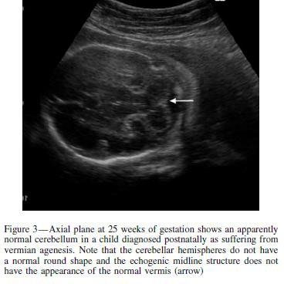
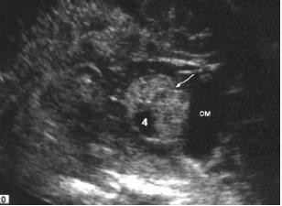
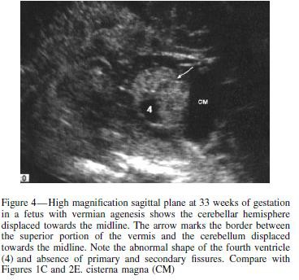
Gustavo M. The fetal cerebellum. Pitfalls in diagnosis and management. Prenat Diagn 2009; 29: 372–380.

Slide 44
LATE DEVELOPMENT OF CEREBELLAR HYPOPLASIA/ATROPHY
Rare disorders with cerebellar hypoplasia that have an onset during fetal or early neonatal life
Pontocerebellar hypoplasias (PCH)
  Progressive degeneration that continues after birth
  Prenatal diagnosis are rare : Normal anomaly screening
Family history of cerebellar hypoplasia
  TCD and ventral pons : evaluated at regular intervals
  Counselling
Gustavo M. The fetal cerebellum. Pitfalls in diagnosis and management. Prenat Diagn 2009; 29: 372–380.

Slide 45
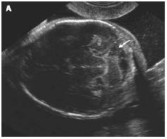
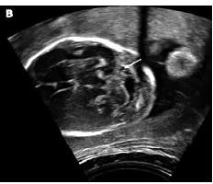

DIFFERENTIAL DIAGNOSIS OF UNILATERAL CEREBELLAR FINDINGS
Usually the result of a focal insult to cerebellum
May be caused by
  Hemorrhage
  Infarction of the cerebellar tissue or surrounding structures
  Intrauterine infection (Cytomegalovirus infection)
Gustavo M. The fetal cerebellum. Pitfalls in diagnosis and management. Prenat Diagn 2009; 29: 372–380.

Slide 46


Slide 47

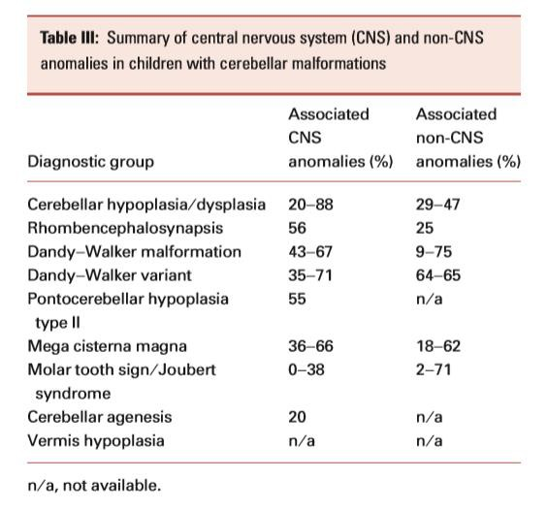

Slide 48

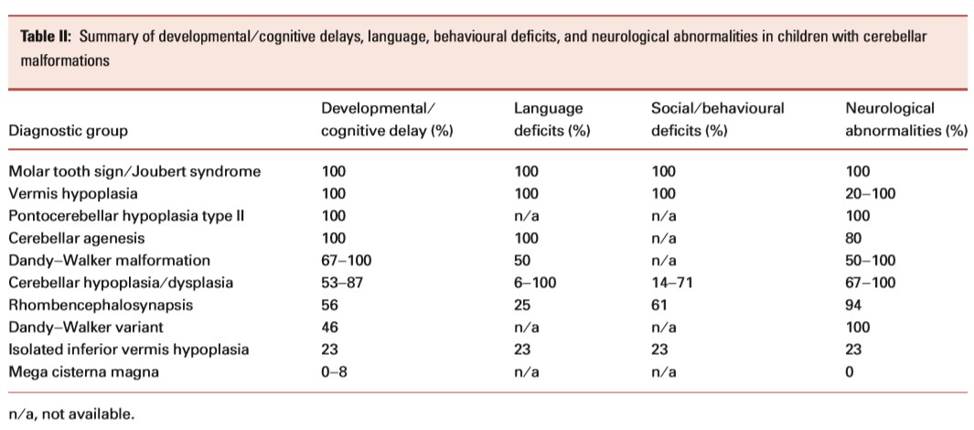

Slide 49
Thank you
for your attention

Slide 50

uiz

Slide 51
