Slide 1

HYPERPROLACTINEMIA
Topic 13/5/56
Presenter : Pitch Chandeying
Adivisor : A.Tawiwan Pantasri

Slide 2
Prolactin
Single gene on chromosome 6 →encode
Secrete : Lactotroph cells of ant. pituitary gland
A single-chain peptide hormone: 199 aa
3 forms : monomer, dimer, multimeric
Growth hormone and placental lactogen → significant lactogenic activity
More than 300 biological functions
^

Slide 3
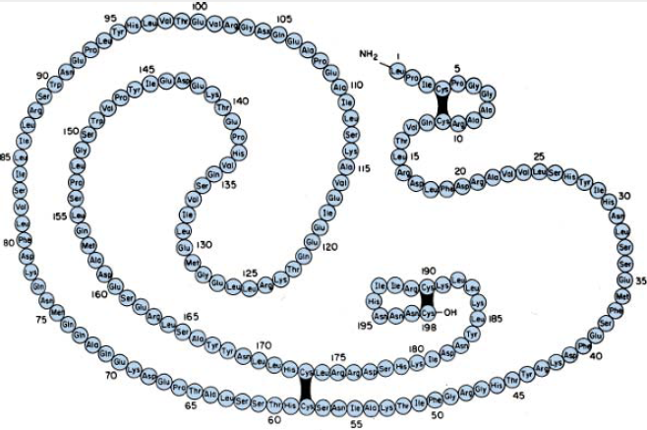
Prolactin

Slide 4
Hyperprolactinemia
One of the most common cause of infertility 30-40%¹
Peak prevalence for women aged 25–34 yr¹
Prevalence varies^{2,3}
  0.4% in the normal adult population
  9-17% in women with menstrual problems such as amenorrhea or polycystic ovarian syndrom
1. G.S. Wand. Diagnosis and management of hyperprolactinemia.Endocrinologist 2003; 13(1):52–57.
2.Biller BM, Luciano A, Crosignani PG, et al. Guidelines for the diagnosis and treatment of hyperprolactinemia. J Reprod Med 1999;44:1075–84.
3.Greer ME, Moraczewski T, Rakoff JS. Prevalence of hyperprolactinemia in anovulatory women. Obstet Gynecol 1980;56:65–9.

Slide 5
Definition
Abnormally high level of prolactin in the blood
Normal levels^{1,2}
  Women < 25 ng/dL
  Men < 20 ng/dL
1.Felipe F. Casanueva, Mark E. Molitch, Janet A. Schlechte, Roger Abs, Vivien Bonert, Marcello D. Bronstein, et al. Guidelines of the Pituitary Society for the diagnosis and management of prolactinomas. Clinical Endocrinology 2006; 65:265–273.
2. Shlomo Melmed, Felipe F. Casanueva, Andrew R. Hoffman, David L. Kleinberg,Victor M. Montori, Janet A. Schlechte,et al. Diagnosis and Treatment of Hyperprolactinemia: An Endocrine Society Clinical Practice Guideline. J Clin Endocrinol Metab, February 2011, 96(2):273–288.

Slide 6
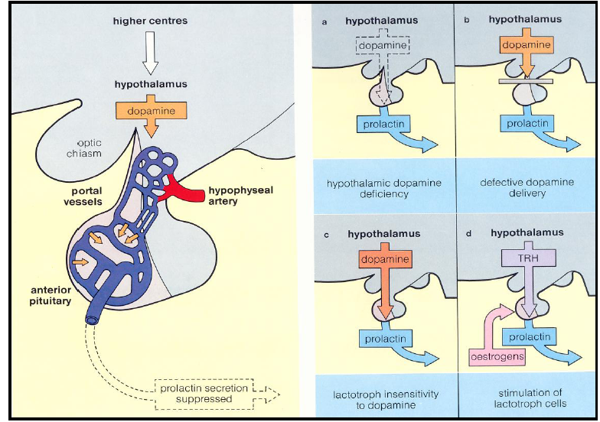

Slide 7
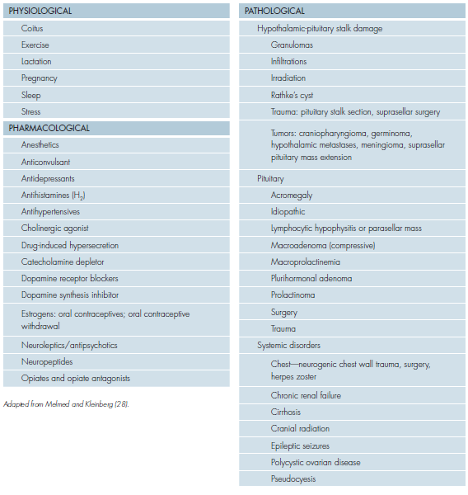

Slide 8
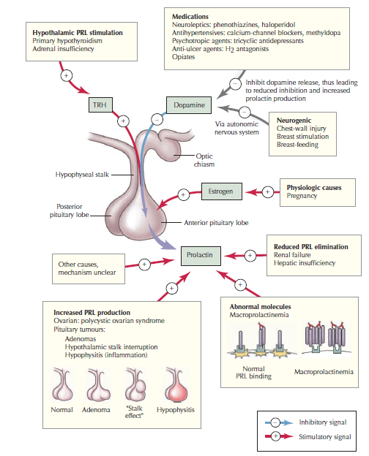

Slide 9
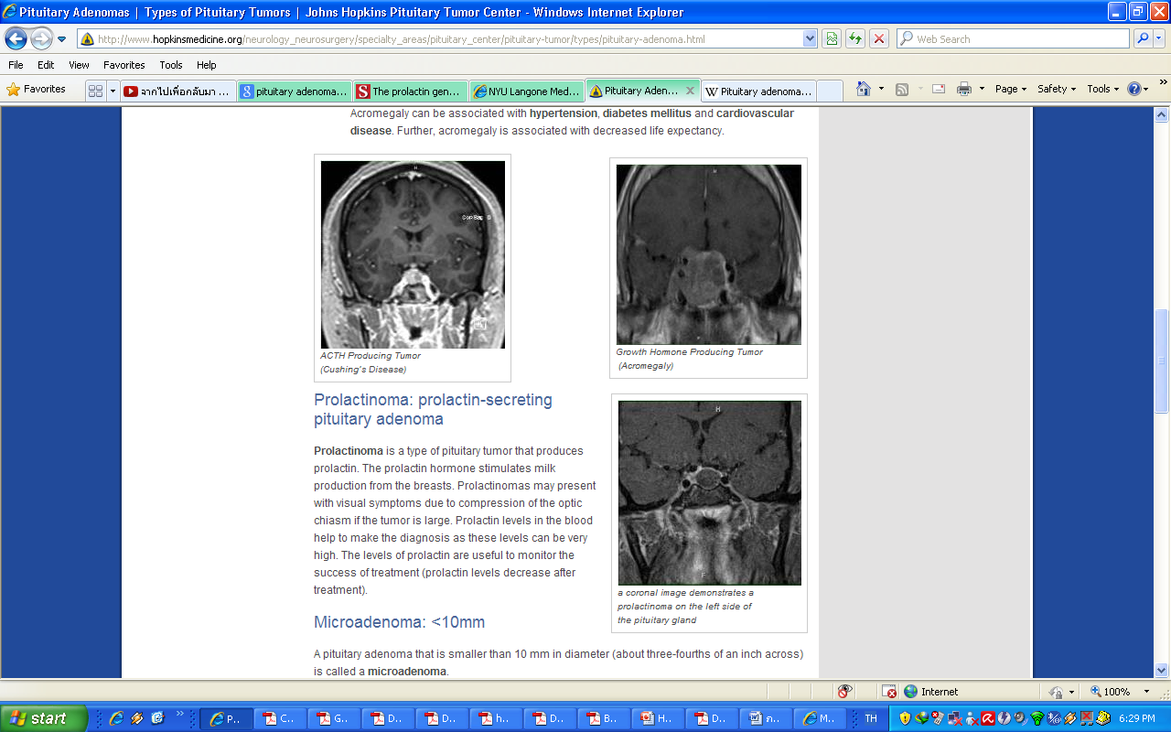
Pituitary tumor
Pituitary adenoma
  common benign tumors of pituitary gland
  Type : Functioning or Non-functioning

Slide 10
Pituitary tumor
Type : microadenoma (diameter < 10 mm) or macroadenoma(diameter ≥ 10 mm)
Pathophysilogy : Release of pituitary stem–cell growth inhibition via activation or loss of function mutations

Slide 11
Prolactinoma
  Prolactin-secreting pituitary adenoma
Most common ~ 30-40% of all pituitary tumor or 25-30% of functioning pituitary tumor → autonomous hormone production, secretion, and cell proliferation.
Additional anatomic factor : reduced dopamine concentrations in the hypophyseal portal system and vascular isolation of the tumor

Slide 12
Idiopathic hyperprolactinemia
30–40% of cases where there is no evidence of abnormal hypothalamic pituitary anatomy
Microprolactinomas develop in approximately 10% of such cases
One-third of patients →spontaneously revert to normal

Slide 13
Iatrogenic hyperprolactinemia
Anti-psychotics, anti-depressants, antiemetics → block the central dopamine system
Opiates → hypothalamic opioid receptors → stimulate prolactin secretion
Estrogen→ action on lactotrophs
Protease inhibitor → unknown

Slide 14
Other causes
Ass. with underlying disease
Hypothyroidism ,adrenal insufficiency → ↑ TRH
Renal failure, hepatic failure → ↓prolactin elimination
PCOS → ↑prolactin production (transient)

Slide 15
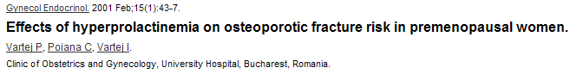
Clinical manifestation
measured in 20 white, premenopausal women with prolactinoma and in 60 healthy control white women → relative risk for developing osteoporosis = 4.5
PRL → stimulate milk production , gonadal function (2nd) , ↓spinal bone mineral density
Large tumor → compression effect
Women :
  Pre. → Oligo/amenorrhe, galactorrhea , infertility
  Post.→ Large adenoma produces mass effects

Slide 16
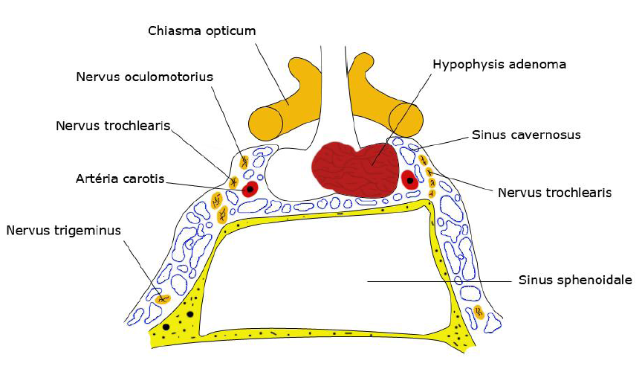
Anatomy of sellar region

Slide 17
Clinical manifestation
Men: impotence, infertility,↓ libido, ↓ sperm production
Child : greater proportion of macroadenomas, delayed puberty
  Boy → similar to what occurs in adult men
  Girl → primary amenorrhoea , galactorrhea

Slide 18
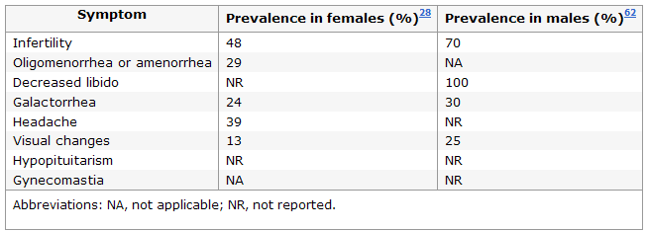
Clinical manifestation¹
1. Smith TP, Kavanagh L, Healy ML, McKenna TJ. Technology insight: measuring prolactin in clinical samples. Nat Clin Pract Endocrinol Metab. 2007 Mar;3(3):279-89.

Slide 19
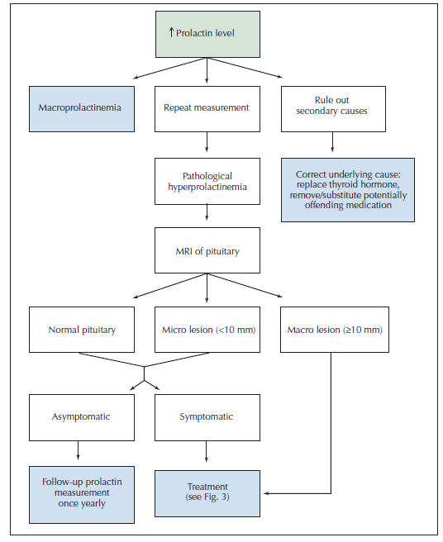
-R/O secondary cause by HX,PE,
UPT, lab (kidney,liver),TSH
-If drug→stop at least 72 hr
Some investigators recommend MRI only in cases where prolactin levels exceed 100 ng/mL
1. Smith TP, Kavanagh L, Healy ML, McKenna TJ. Technology insight: measuring prolactin in clinical samples. Nat Clin Pract Endocrinol Metab. 2007 Mar;3(3):279-89.

Slide 20
Macroprolactin
Called “Pseudo-hyperprolactinemia”
a polymeric form of prolactin (PRL+IgG)
Reduced rate of clearance & less bioactivity
Asymptomatic patients with intact gonadal and reproductive function and mod. elevated PRL
Polyethylene glycol precipitation Vs gel-filtration chromatography
No specific treatment is needed.
Notes:
Not ass. With macroprolactinoma -macroprolactinemia
-GFC : as determined by analysis of area under the PRL curve is 30% of the total area of PRL elution.
---PEG precipitation is 27 times cheaper than GFC
----Prevalence 10–25% in hyperprolactinemia and 3.7% in general population

Slide 21
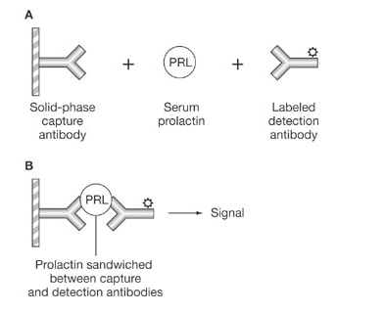
Immunoradiometric assay
Smith TP, Kavanagh L, Healy ML, McKenna TJ. Technology insight: measuring prolactin in clinical samples. Nat Clin Pract Endocrinol Metab. 2007 Mar;3(3):279-89.

Slide 22
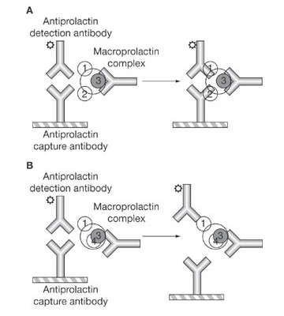
Smith TP, Kavanagh L, Healy ML, McKenna TJ. Technology insight: measuring prolactin in clinical samples. Nat Clin Pract Endocrinol Metab. 2007 Mar;3(3):279-89.

Slide 23
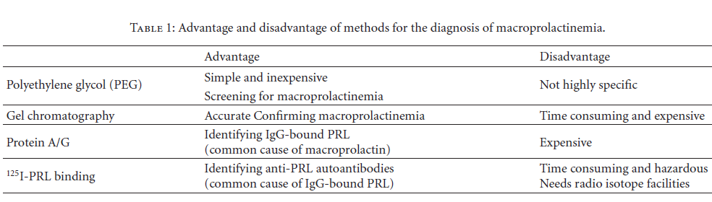
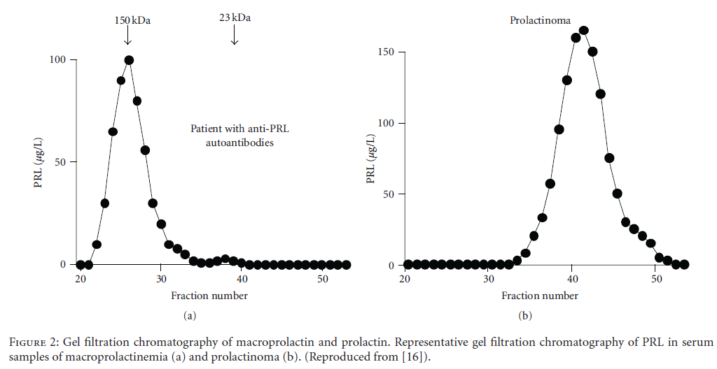

Slide 24
Hook effect
All new patients with large pituitary macroadenomas with normal or mildly elevated PRL levels
Extremely high serum PRL concentration → antibody saturation in the immunoradiometric assay →artifactually low results
a serum dilution at 1 : 100 → eliminate excess unbound PRL

Slide 25
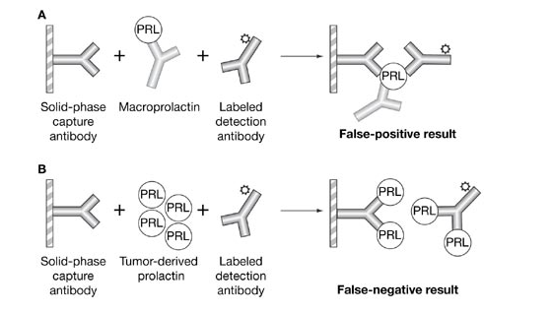
Smith TP, Kavanagh L, Healy ML, McKenna TJ. Technology insight: measuring prolactin in clinical samples. Nat Clin Pract Endocrinol Metab. 2007 Mar;3(3):279-89.

Slide 26


Slide 27
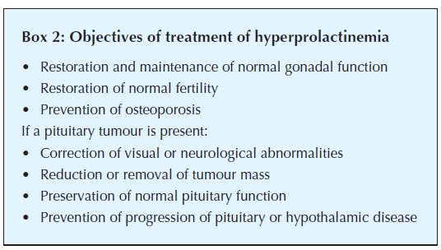
Management

Slide 28
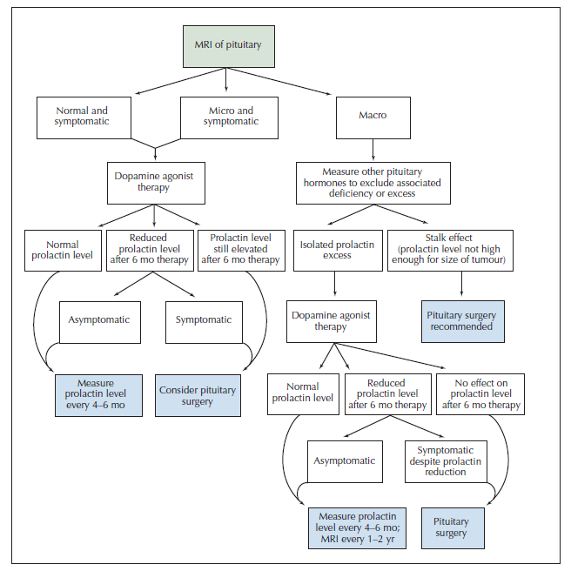

Slide 29
Management
Pituitary tumor
Non-pituitary tumor
Idiopathic hyperprolactiemia

Slide 30
Management
Pituitary tumor
Non-pituitary tumor
Idiopathic hyperprolactiemia

Slide 31
Pituitary tumor
Microadenoma
  Expectant management
  Medical treatment
Macroadenoma
  Medical treatment
  Surgical treatment
  Radiation therapy

Slide 32
Expectant management
microadenomas and hyperprolactinemia in the absence of an adenoma if menstrual function remains intact : Do not desire fertility
Imaging → repeated in 12 months
And if prolactin stable → less frequently to assess tumor growth

Slide 33
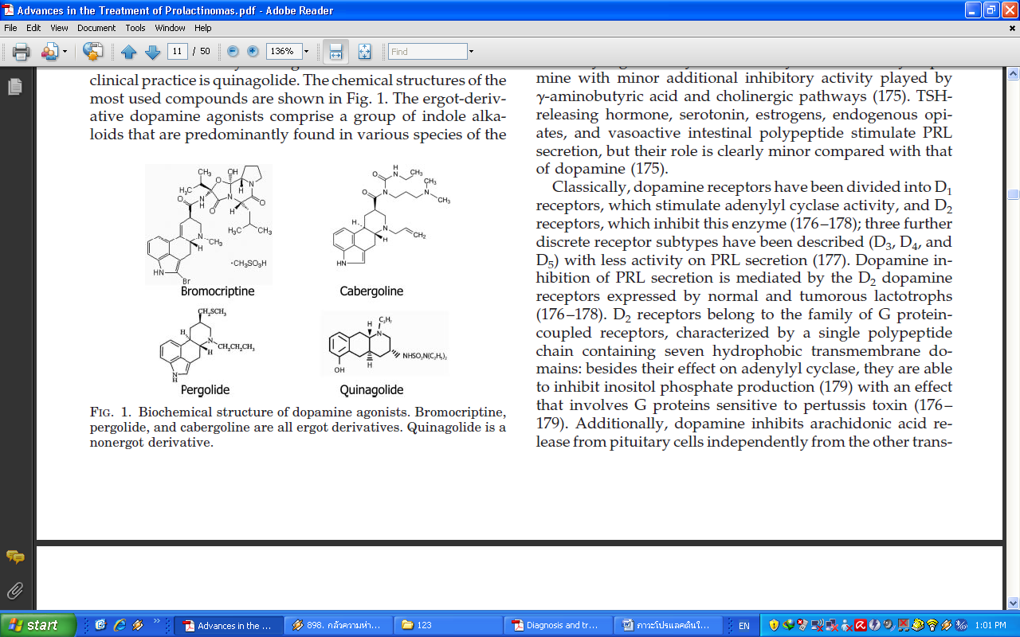
Medical treatment
Ergot derivative treatment
Non-ergot derivative treatment

Slide 34
Dopamine agonist
The first therapeutic option
Very effective for prolactinomas and symptomatic idiopathic hyperprolactinemia
↓prolactin levels, restoring ovulation in premenopausal women& gonadal function in men
Hyperprolactinemia will recur in the majority of patients after dopamine agonist withdrawal

Slide 35
Dopamine receptor
G protein–coupled receptors with seven-transmembrane domains
Subtypes
  D1, D5: stimulatory G protein alpha subunits →activate adenylate cyclase, ↑cAMP production
  D2, D3, D4 : inhibitory G protein alpha subunits → inh. adenylate cyclase, ↓cAMP production
D2 → subtype of dopamine receptors expressed by the pituitary gland

Slide 36
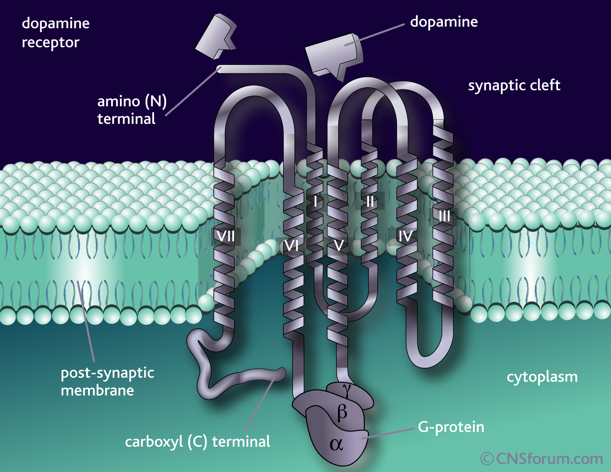

Slide 37
D2 subtype receptor
Decreased cellular metabolism
Decreased prolactin gene transcription
Decreased cell size (↓cytoplasmic, ↓ nuclear, ↓ nucleolar areas) → ↓ tumor size
Cell death
Notes:
- with involution of the endoplasmic reticulum and Golgi complex

Slide 38
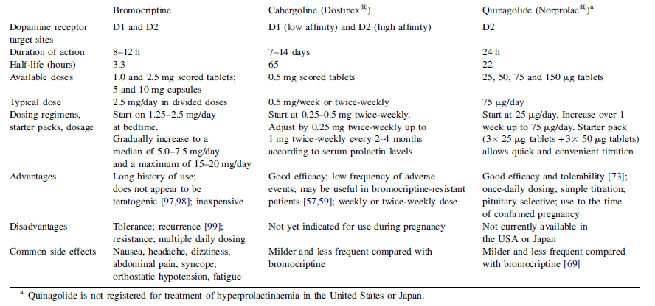

Slide 39
Bromocriptine
Ergot derivative agent
stimulates D2-type dopamine receptors
both antagonise and stimulate D1-type receptors → mild adrenal side effect
Advantage
  Inexpensive treatment
  The longest history of use
  Well established as a safe and effective therapy

Slide 40
Bromocriptine
Disadventage
  SE : nausea, headache, dizziness, abdominal pain, syncope, orthostatic hypotension and fatigue
  short half-life (3.3 h) → multiple dose daily (↑frequent → ↓Compliance )
  Aware in hepatic disease
side effects, tolerability ,resistance → alternative dopamine agonists
Continue at least 2yr → discontinue if normal PRL +no tumor on MRI (The 2011 Endocrine Society Clinical Practice Guideline on diagnosis and treatment of hyperprolactinemia)
Notes:
Measurement of serum prolactin levels every 3 months for the first year and then annually thereafter; and
MRI if prolactin increases above normal levels

Slide 41
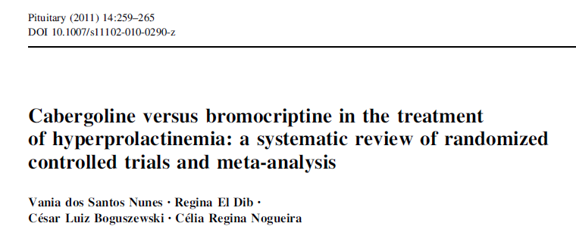
Cabergoline(Dostinex®)
Ergot derivative agent
High affinity for D2-type receptors & low affinity for D1-type receptors
effectively treats idiopathic hyperPRL, microadenomas and macroadenomas
Adventage
  Long acting agent (HL 65 hr)→ weekly, 2/wk
  Low side effects
  Effective for resistance or intolerant patient
418 reference → 34 article → 15 article were included :
-cabergoline group →normalization of serum prolactin levels and menstruation with return of ovulatory cycle
-adverse effects was significantly higher in the bromocriptine
Notes:
- เนื่องจาก hLที่ยาวทำให้การเปลี่ยนแปลงของระดับความเข้มข้นของยาในเลือดน้อย

Slide 42
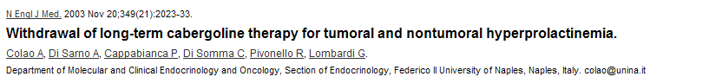
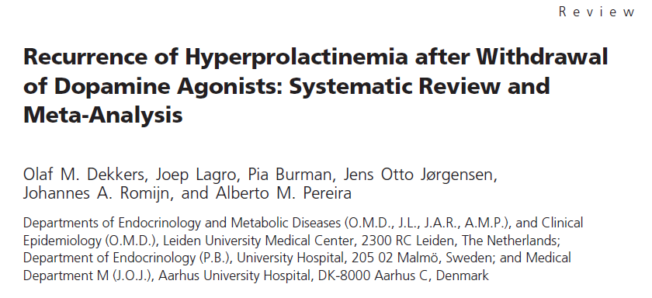
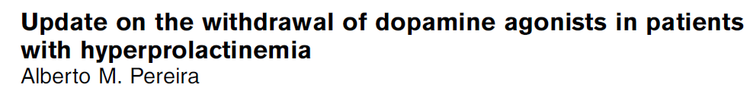
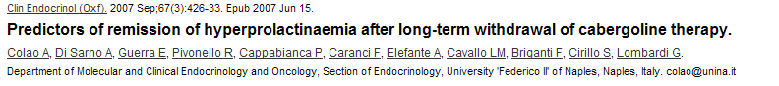
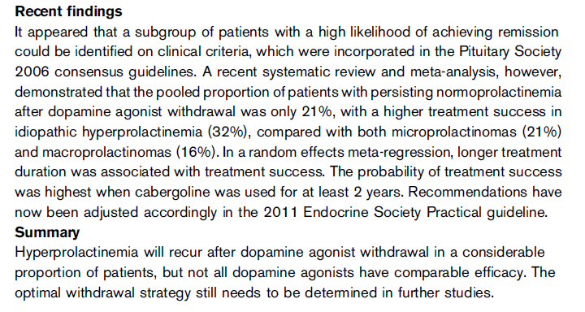
Cabergoline(Dostinex®)
Current Opinion in Endocrinology,
Diabetes & Obesity 2011, 18:264–268
19 studies , with a total of 743 patients
a good safety record in the small number (approximately 300) of cases in which it was taken during early pregnancy → But not approve in pregnancy
Discontinue drug → need more research

Slide 43
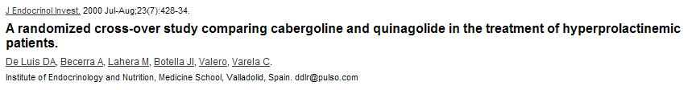

Quinagolide (Norprolac®)
Avialable in Canada and Europe
Non-ergot derivative agent
second-generation dopamine agonist
a specific D2-type receptor agonist
Compare with
  Bromocriptine : more effective & better tolerated
  Cabergoline : similar between treatments in terms of improvements and no difference in the occurrence of side-effects

Slide 44
Quinagolide (Norprolac®)
Adventage
  Fewer side effects : peripheral vasospasm, erythromelalgia, pleuropulmonary or retroperitoneal fibrosis
  HL 22 hr → once daily
  Good tolerability
  Effective in bromocriptine resistant prolactinoma
an alternative dopamine agonist but with limited access

Slide 45
Pergolide(Permax®)
An ergoline-based dopamine receptor agonist
Some countries : Rx. Parkinson’s disease
Not available for use by humans in USA
In 2007, pergolide was withdrawn from the U.S. market for human use →↑ vulvular heart disease
Agonist at the dopamine D₂, D_{1(weak)} and serotonin receptor

Slide 46
Surgical treatment
Resistance or intolerance to optimal medical therapy
Patients with intrasellar tumour for whom long-term drug treatment is not acceptable
Tumors pressing on the optic chiasm
Avoided in cases of extrasellar (without optic chiasm compression) expanding tumors because of the low success rate

Slide 47
Surgical treatment
Endoscopic transphenoidal surgery
Does not reliably lead to a long-term cure & recurrence of hyperprolactinaemia is frequent
Successful rate
  Micro : long-term success rate 75% (PRL<200ng/dL)
  Macro : long-term success rate about 26% (if cavernous sinus extension → not cured)

Slide 48
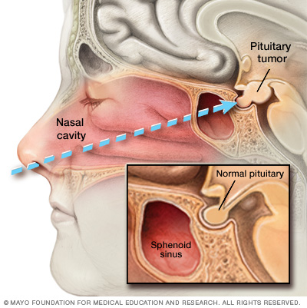

Slide 49
Radiation therapy
Not an acceptable primary therapy
side-effects : hypopituitarism, damage to the optic nerve, neurological dysfunction, stroke and secondary brain tumors
Indication
  Do not respond to dopamine agonists
  Not cured by surgery

Slide 50
Management
Pituitary tumor
Non-pituitary tumor
Idiopathic hyperprolactiemia

Slide 51
Non pituitary tumor
Drug induced hyperprolactinemia
Metabolic causes

Slide 52
Hyperprolactin in pregnancy¹
Discontinue dopamine agonist therapy
Against performing prolactin measurement
Against the use of routine pituitary MRI
Surgical resection before pregnancy
Use the clinical examination rather than MRI
Symptomatic growth →Use bromocriptine
1. Shlomo Melmed, Felipe F. Casanueva, Andrew R. Hoffman, David L. Kleinberg,Victor M. Montori, Janet A. Schlechte,et al. Diagnosis and Treatment of Hyperprolactinemia: An Endocrine Society Clinical Practice Guideline. J Clin Endocrinol Metab, February 2011, 96(2):273–288.

Slide 53
Hyperprolactin in pregnancy
No evidence of increased teratogenicity : Use bromocriptine or cabergoline
Should be evaluated every 2 months
Breast feeding → no evidence of tumor growth

Slide 54
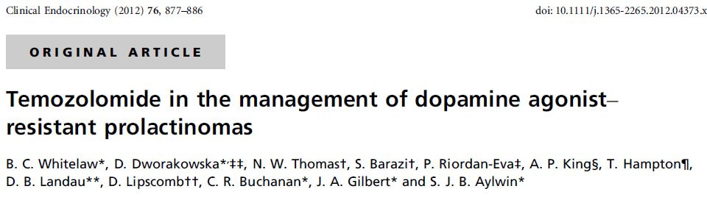
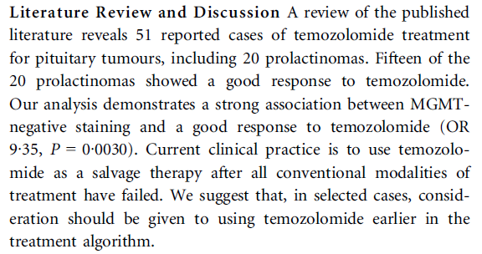
Dopamine resistant hyperprolactinemia
Increased to maximal tolerable doses before referring the patient for surgery
Resistant to bromocriptine be switched to cabergoline
Offer transsphenoidal surgery to symptomatic patients with prolactinomas
Suggest temozolomide therapy malignant prolactinomas
Notes:
3-cannot tolerate high doses of cabergoline or who are not responsive to dopamine agonist therapy
4-Temozolomide has been shown to reduce prolactin levels and control tumor growth if tumor specimens do not express methylguanine-DNA methyl transferase

Slide 55

Thank you
THANK YOU
FOR
YOUR ATTENTION
☺

