Slide 1
Common drug Toxicities in Gynecologic Malignancy
ATITA RUENGSAEN M.D.
ASSITANT PROF. SITTHICHA SIRIAREE
b Title of Your Presentation

Slide 2
Outlines
01
Principle of Chemotherapy
02
Chemotherapy classifications
03
Toxicities & Management

Slide 3
History of Cancer Treatment
150 years : Fowler solution (Arsenic) in Pts Hodgkin and Leukemia
1910 : Paul Ehrlich,Salvarsan used to cure Syphilis
1942 : Nitrogen mustard in Lymphoma in Mice
1948: Aminopterin in Leukemia child
1940s: Antitumor effect of Estrogens in CA Prostate
1

Slide 4
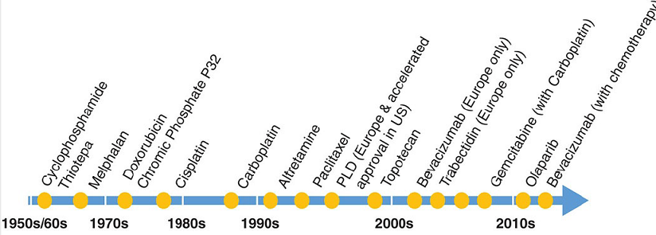
Timeline of Chemotherapy
2
Principles and practice of gynecologic oncology, 7th edition

Slide 5
Treatment Decisions
Patient
-Age, general health, medical comorbidities, performance status, previous treatment,
-Availability of facilities to evaluate, monitor, and treat potential drug toxicities
-The emotional, social, and financial problem
National history of cancer
Clinical Benefit
Diagnosis Prognosis
Cure rate,PFS,OS,recurrent rate,response rate
3

Slide 6
3 Categories
of CMT
Highly chemosensitive tumors
-Ovarian germ cell tumors
-GTN
Based on Response and Treatment Benefit
Chemosensitive,
cure is uncommon
- EOC (High grade serous)
Low response to chemotherapy
-LMS
-Platinum resistant OC
Berek & Hacker’s Gynecologic Oncology,6th edition
4

Slide 7
Challenges in Cancer Patients
Narrow therapeutic window between antitumor effect and toxicity
Cancer chemotherapy requires a balance of therapeutic effect and toxicity to optimize the therapeutic index.
5

Slide 8
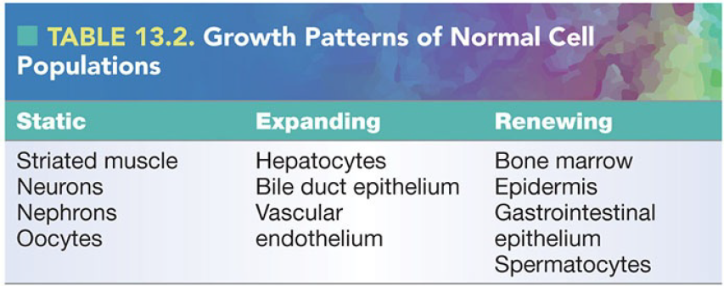
Normal cell
6

Slide 9
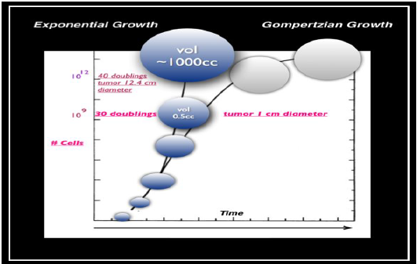
Exponential Growth VS
Gompertzian Growth
“Cell Kinetic” Concepts
7
Notes:
In 1825, Gompertz proposed that tumors grow in a sigmoidal
pattern, with the fastest growth occurring when tumors are about one-third of their maximum
size, with growth slowing as tumors get larger.
tumor mass increases in size, the time required to
double the tumor’s volume also increases. This suggests that small tumors and micrometastases
should be more sensitive to chemotherapy

Slide 10
Doubling Time
Single cell
Tumor size | Doubling
1 mm. | 20
5 mm. | 27
1 cm. | 30
*Germ cell tumors :fast doubling times (20 to 40 days)
*AdenoCA,SCC :slow doubling times (50 to 150 days)
*Metastases have faster doubling times than primary tumors.
8
Notes:
Time

Slide 11
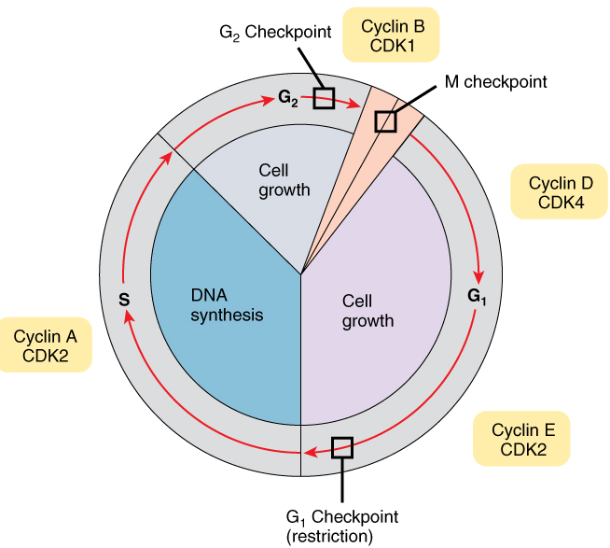
Cell Cycle
-G1phase (postmitotic) : Variable,longest
-S phase (DNA synthetic) : 8 hrs
-G2 phase (postsynthetic)
:2 hrs
-M phase (mitotic)
: 1 hr
-G0 phase (resting phase)
9

Slide 12
Cell Cycle specific VS
Non-specific
Cell Cycle–Nonspecific: kill in all phases of the cell cycle and have limited dependency on proliferative activity ;alkylating agents, antitumor antibiotics, hormonal therapies.
Cell Cycle–Specific: act only at particular phases of the cell cycle
10

Slide 13
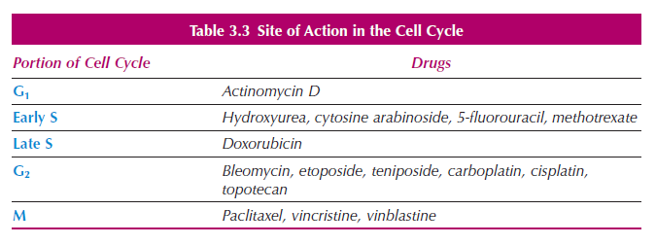
Site of Action in Cell Cycle
11
Berek & Hacker’s Gynecologic Oncology,6th edition

Slide 14
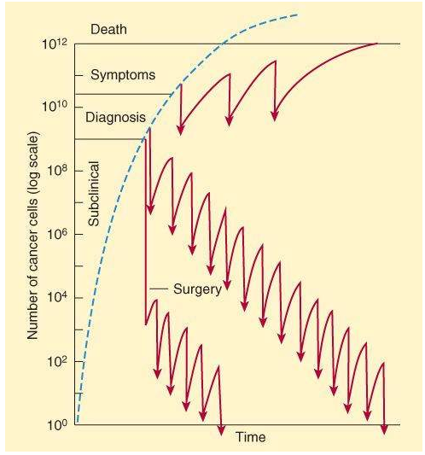
Untreat
Log kill cell hypothesis
Treatment immediately after
tumor implantation, or when the tumor is subclinical in size, results in a higher chance of cure
CMT
12
Notes:
they kill a constant fraction of cells rather than a constant (109= tumor 1 gm)
number of cells. producing 2- to 5-logs of cell kill. With
typical body tumor burdens of 10¹² cells (1 kg)

Slide 15
Pharmacology of Chemotherapy
Drug absorption
Distribution
Metabolism
Excretion
Oral
IV,IA
IM
Intralesion
IP : cisplatin, carboplatin, and paclitaxel
13

Slide 16
Pharmacology of Chemotherapy
Drug absorption
Distribution
Metabolism
Excretion
Plasma protein binding
Sanctuary sites :CSF Large tumor masses with central tumor necrosis + a low oxygen tension.
Simple diffusion
Cell penetration
14

Slide 17
Pharmacology of Chemotherapy
Drug absorption
Distribution
Metabolism
Excretion
Metabolizing>>
Active form
15

Slide 18
Pharmacology of Chemotherapy
Drug absorption
Distribution
Metabolism
Excretion
-Most
Kidney or Liver
-Bile
-Stool
-Respiration
16

Slide 19
Chemotherapy classifications
Class | Mechanism | Examples
Platinum analog | DNA adduct | Carboplatin,Cisplatin, Oxalipatin
Alkylating agents | DNA adduct | Cyclophosphamide,Ifos
Antitumor Antibiotics | DNA intercalation => free radicals | Act-D,Bleomycin,Doxorubicin, Lipodox
Antimetabolites | Analogues of metabolites involved in DNA/RNA synthesis | 5-FU,MTX,Gemcitabine
Anti-microtubule | Prevent microtubule formation/ dissemble | Vinca alkaloids (vincristine, vinorelbine),Taxanes
Topoisomerase 1 and 2 Inhibitors | Topoisomerase inhibition | Top I inhibitors (topotecan) Top II inhibitors (etoposide)
17

Slide 20
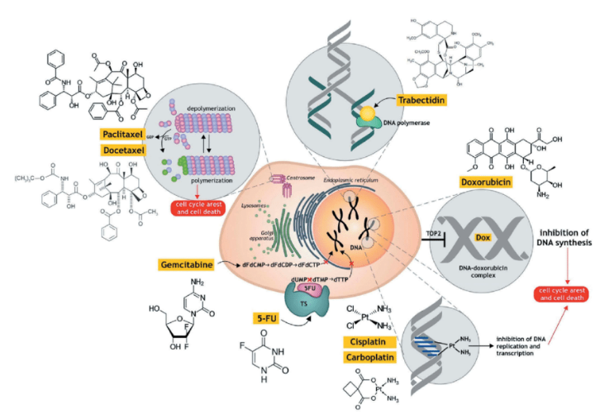
Researchgate.com

Slide 21
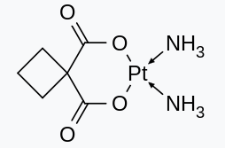
PLATINUM
cis-diammine-
(1,1cyclobutanedicarboxylato)
platinum(II)
CARBOPLATIN
-Binding to the N-7 position of guanine
-Inhibition of DNA, RNA, and protein synthesis
-Infusion in 0.9% NSS or 5% DW
-IV,IP
- Crcl : Calvert Formula
- AUC (mg/mL · min) × [GFR (mL/min) + 25]
18

Slide 22
PLATINUM
Bone marrow suppression (esp. platelet)
CARBOPLATIN
Transient increasing ALP (36%)
Transient increasing AST/ALT (15%)
Increasing bilirubin (4%)
Toxicities
-Neurotoxicity (rare)
-Ototoxicity (rare)
- N/V, E’lyte imbalance, HypoMg
- Hypersensitivity (uncommon)
19
Notes:
6 to 12 days after administration of most myelosuppressive
chemotherapeutic agents, and recovery occurs within 21 days; platelet suppression occurs 4 to 5 days
later, with recovery after white cell count recover

Slide 23
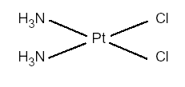
PLATINUM
cis–diamminedichloroplatinum II
CISPLATIN
-Same as Carboplatin
-Infusion Only 0.9% NSS
(Drug stability)
-90% excretion at kidney
-Significant accumulation (year)
20

Slide 24
PLATINUM
- Renal tubular damage (Rising BUN/Cr)
- D10-D20 of Treatment
- Rx: Hydration, Mannitol
CISPLATIN
- Ototoxicity : Uni/Bilat. hearing loss
- Occasional tinnitus
- Rx: Hydration, Mannitol
Toxicities
-Neurotoxicity : peripheral neuropathy
-Cumulative doses of >300 mg/m2: More severe
- N/V, E’lyte imbalance, HypoMg (severe)
- Anaphylactic Hypersensitivity
21

Slide 25
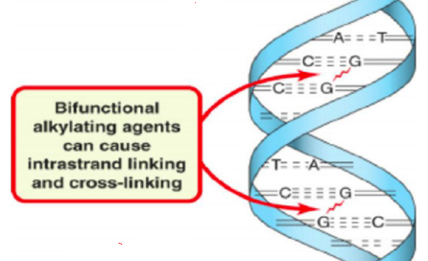
Alkylating agents
-Cyclic phosphamide ester of nitrogen mustard
-Activation by P450
Cyclophosphamide
-Bifunction
-Interstrand cross-link DNA
-Renal elimination (Most)
- Significantly prolonged retention
22

Slide 26
Alkylating agents
Acute, sterile hemorrhagic cystitis
Acrolein (Toxic metabolite)
Onset 24hr-several weeks
Rx: Prophylactic hydration with intake of
at least 3 L/d
N-acetylcysteine or mesna (sodium
mercaptoethanesulfonate)
Cyclophosphamide
Toxicities
-SIADH (water intoxication)
-Dose > 50 mg/kg
N/V
alopecia
Bone marrow suppression
Interstitial pneumonitis (rare)
23

Slide 27
Alkylating agents
-Analog of Cyclophosphamide
-Activation by P450
-HL > cyclophosphamide
Ifosfamide
-Bifunction
-Interstrand cross-link DNA
-Renal elimination (Most)
-Penetration to the blood–brain barrier
24

Slide 28
Alkylating agents
Acute, sterile hemorrhagic cystitis
Same as Cyclophosphamide
Ifosfamide
- Lethargy and confusion
Seizures, ataxia, stupor, and weakness
- Chloracetaldehyde metabolite
- Observe 1to 8 hour>>> spontaneous reversible
Toxicities
Drugs interaction with
Cisplatin,Cimethidine
25

Slide 29
Anti-tumor
Antibiotics
Isolated from Streptomyces
parvulus
Actinomycin-D
-Intercalation DNA
-Cell cycle Non specific
-Maximal cell killing G1 phase
-Infusion in 0.9% NSS or 5% DW
-IV “short pulse”
- Excretion : Urine, fecal
26

Slide 30
Anti-tumor
Antibiotics
Bone marrow suppression
Actinomycin-D
Severe N/V ,severe oral ulcer
Diarrhea
Toxicities
- Acneiform changes, erythema, and hyperpigmentation
- Alopecia
Extravasation
27

Slide 31
Anti-tumor
Antibiotics
Strain of the fungus
Streptomyces verticillis
Bleomycin
- DNA strand breaks by o₂ free radicals
- Cell cycle depend G2 phase
-IV ,IM
- Excretion : Urine
28

Slide 32
Anti-tumor
Antibiotics
-Pneumonitis
-Advanced age
accumulative dose 400U
-Chronic lung fibrosis
-Pulmonary function tests before the
initiation of treatment, and
day one of each subsequent cycle
Bleomycin
Toxicities
Hyperpigmentation, erythema, rash, striae, pruritus, thickening of the nail
beds, scleroderma (rare)
- Mucositis
- Mild N/V
29
Notes:
Stop drug if pneumonitis

Slide 33
Anti-tumor
Antibiotics
Anthracycline antibiotic
Streptomyces peucetius var. caesius
Doxorubicin
-Intercalation between stacked nucleotide pairs
-Inhibition of DNA Topoisomerase II
-IV (push/bolus)
- Biliary excretion (40%)
30

Slide 34
Researchgate.com

Slide 35
Anti-tumor
Antibiotics
-Pericarditis–myocarditis
-Cardiomyopathy
(>Cumulative Dose 550 mg/m2)
-Dexrazoxane (Zinecard) is a
chemoprotective agent
Doxorubicin
Toxicities
-Hyperpigmentation: skin,nail bed
-Extravasation
-Marked alopecia
-Stomatitis,diarrhea
31
Notes:
monitoring of left ventricular
function by means of ejection fraction studies, therapy can be continued to higher doses if
no satisfactory alternative exist,aviud HF

Slide 36
Anti-tumor
Antibiotics
-Surface-bound MPEG
-Protect liposomes from detection by the
mononuclear phagocyte
Increasing blood circulation time
Liposomal Encapsulated Doxorubicin
-IV
-Long HL
-16x tumor cell concentration
- Biliary excretion
32

Slide 37
Anti-tumor
Antibiotics
-Minimal cardiotoxicity, alopecia, and
nausea/vomiting
Liposomal Encapsulated Doxorubicin
-PPE (26%) dose 50 mg/m2 every 4 weeks
-Stomatitis
Toxicities
Infusion-related reactions (<10%)
33

Slide 38
Antimetabolite
Fluorinated pyrimidine differing from
the normal DNA
-Inhibition the formation of the DNA-specific nucleoside base thymidine
-Cell cycle specific agent (S phase)
5-FU
-IV
-Metabolization in the liver (80%)
-Drug interaction : MTX
34
Notes:
5 FU ลดMTX metabolism

Slide 39
Researchgate.com

Slide 40
Antimetabolite
-Stomatitis
-Oral ulcer
-Diarrhea, proctitis, and esophagitis
5-FU
-Bone marrow suppression
Toxicities
1.2- 18%
Myocardial infarction, angina, dysrhythmias, Cardiogenic shock,
Sudden death
EKG changes
-Hyperpigmentation over the veins
-Alopecia (some degrees)
-Headache, minor visual disturbances, cerebellar ataxia (rare)
35

Slide 41
Antimetabolite
Cell cycle–specific antifolate analog
MTX
Blocking amino acid synthesis
-Oral, IM, IV, Intra-arterial, Intrathecal
-Excretion: liver,kidney
-Drug interaction : 5-FU
36
Notes:
MTX เพิ่ม 5FU

Slide 42
Antimetabolite
-Stomatitis
-Oral ulcer
-Gingivitis, proctitis, and esophagitis
MTX
-Bone marrow suppression
Toxicities
-Hepatocellular injury
(return to normal 1 week)
Rx: Leucovorin rescue
-Skin : Erythematous rashes, pruritus, urticaria, folliculitis, vasculitis, photosensitivity, depigmentation, hyperpigmentation. Alopecia
-Neuro : Encephalopathy, dizziness, malaise, and blurred vision
37
Notes:
Liver toxicity >>> liver cirrhosis

Slide 43
Antimetabolite
Synthetic nucleoside analog
Gemcitabine
-Prodrug
- Blocking amino acid synthesis
-IV
-Excretion: kidney
38

Slide 44
Antimetabolite
Subcutaneous edema, including
peripheral edema and facial edema
Gemcitabine
-Bone marrow suppression (Gr3-4)
Toxicities
- Low incidence of liver and renal toxicities
Cutaneous reactions :
erythema in mild cases (15.5%) and dry desquamation, vesiculation, and/or pruritus
in moderate cases (9.1%). Moist desquamation and ulceration (rare)

Slide 45
Anti microtubules
The bark of the Pacific yew,
Taxus baccata.
Paclitaxel
-Mitotic spindle inhibitors
-Prevents cellular replication
-IV,IP
-Hepatic metabolism and biliary
Excretion
- 70-80% Fecal
39

Slide 46
Researchgate.com

Slide 47
Anti microtubules
Hypersensitivity reactions (25-30%)
Rx: If severe :IV epinephrine,
IV diphenhydramine, IV fluids
nebulized beta-agonists,
steroid therapy
Paclitaxel
Toxicities
- Cardiac arrhythmias
-Peripheral neuropathy
-Bone marrow suppression
-Alopecia
-Myalgias, arthralgias
40

Slide 48
Anti microtubules
Vincristine (oncovin), vinblastine,
Vindesine, Vinorelbine (3rd gen)
Vinca alkaloids
-Mitotic spindle inhibitors
-Prevents cellular replication
-IV
-Hepatic metabolism and biliary
Excretion
- Urine, Fecal
41

Slide 49
Anti microtubules
Peripheral motor, sensory, and autonomic neuropathy
-loss of deep tendon reflexes (first)
- Distal paresthesia
- Cranial nerves defect
- Adynamic ileus
- Urinary bladder atony+retention
- Postural hypotension
Vinca alkaloids
Toxicities
Vesicants
42

Slide 50
Topoisomerase 1, 2 Inhibitors
Semisynthetic epipodophyllotoxin
from the root of Podophyllum
Etoposide
-Protein-linked DNA strand breaks by inhibiting DNA TOPOII enzymes
-S-G2 phase
Oral(capsule),IV
Excretion: Kidney
43

Slide 51
Topoisomerase 1, 2 Inhibitors
- Nausea, vomiting, anorexia (mild)
- Mucositis
Etoposide
-Bone marrow suppression
Toxicities
Secondary malignancy: AML
Prolong Etoposide (5-8 years )
44

Slide 52
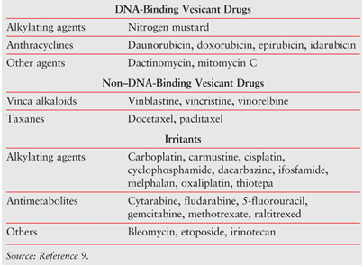
Vesicant Drugs
45
Notes:
Vesicants can cause redness and blistering. Larger amounts of vesicant leakage from the chemotherapy injection can lead to severe skin damage in a matter of days.
Symptoms from leakage of vesicants may be delayed for up to 6-12 hours after chemotherapy injection

Slide 53
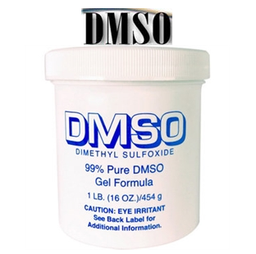
Treatment
-Cold compress
-Warm compress
(Vinca alkaloids, Taxol)
-Topical DMSO
(99% DMSO)
46
Notes:
Mitomycin:DMSO every 6 hours for 14 days

Slide 54
Take home message
Considerations before using chemotherapy
- National history of cancer
- Patient
- Supportive care
- Treatments goal
47

Slide 55
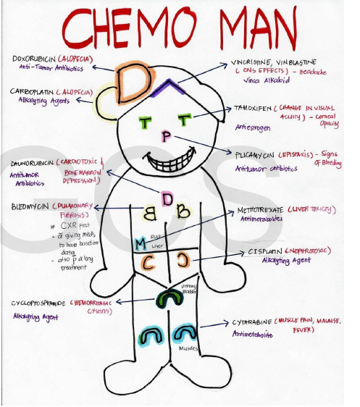

Slide 56
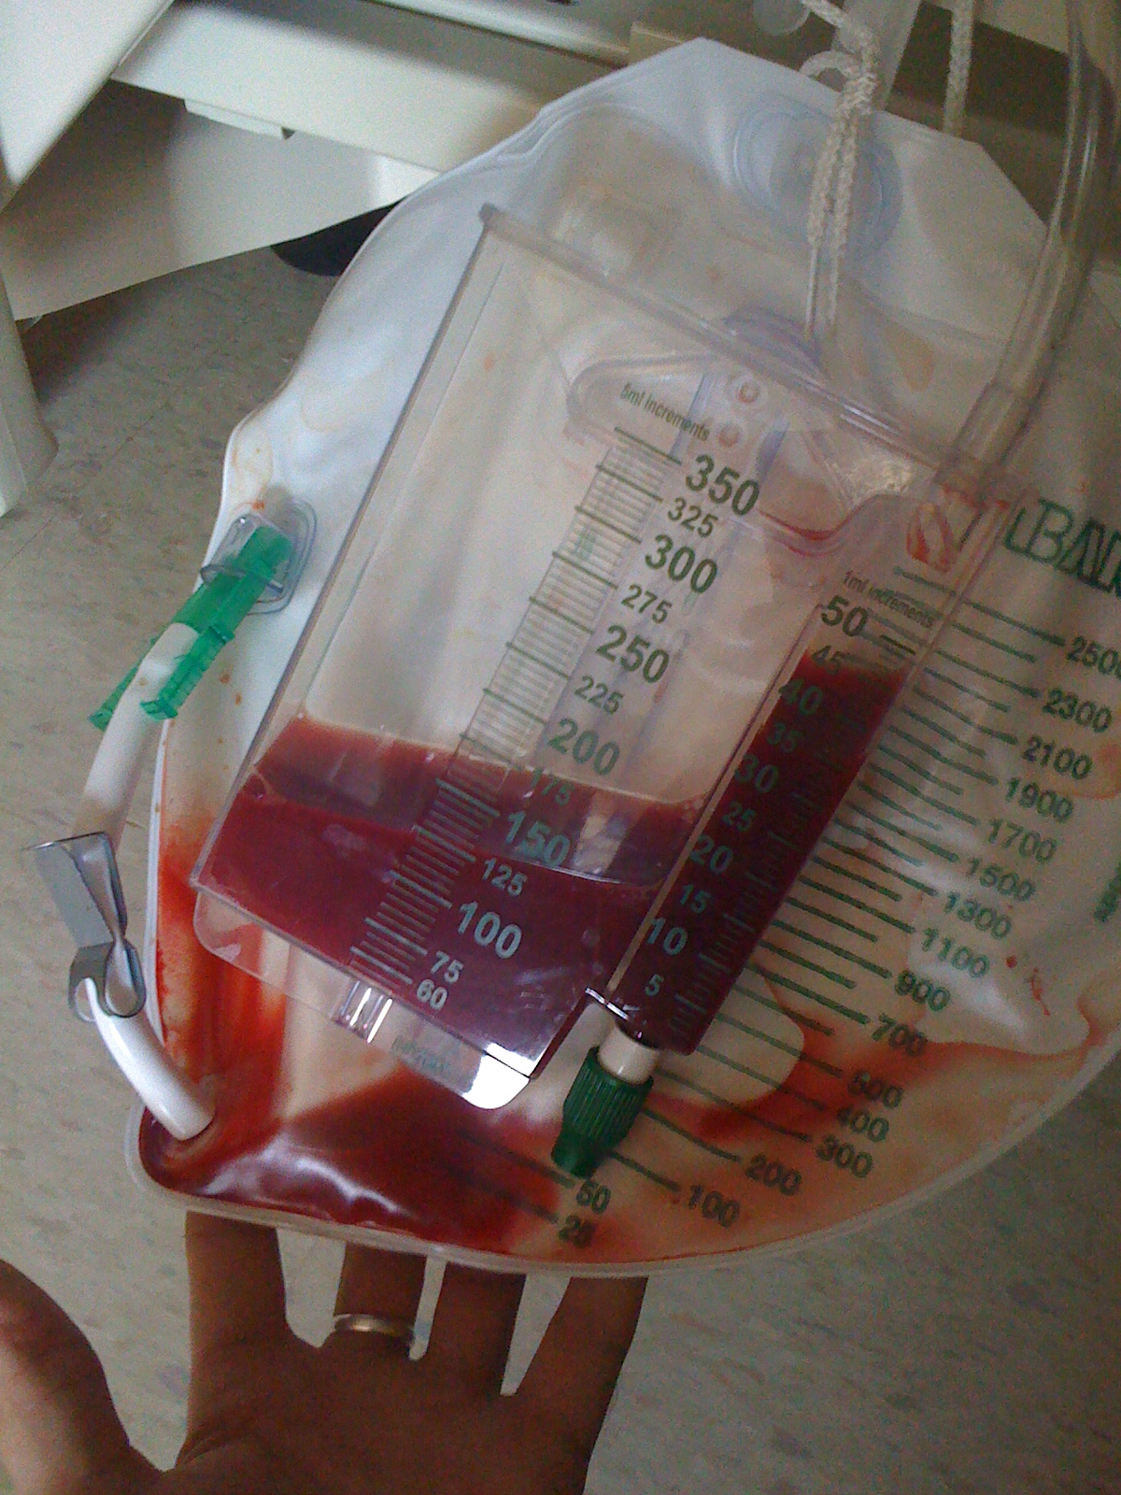
Quiz 1
-Cyclophosphamide
-Ifosfamide

Slide 57
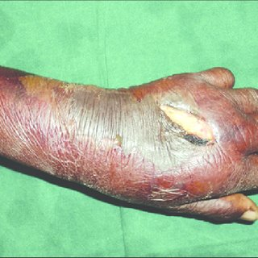
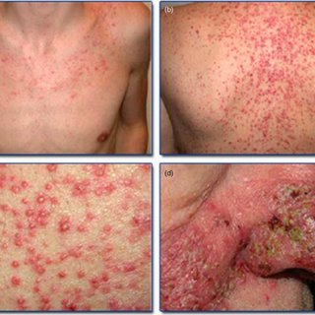
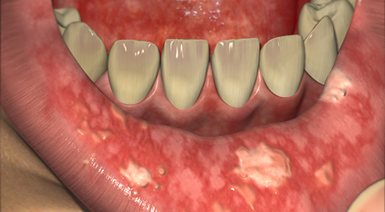
Quiz 2
Actinomycin-D

Slide 58
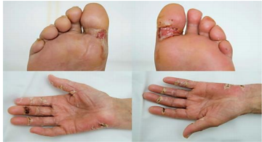
Quiz 3
PALMAR-PLANTAR ERYTHRODYSESTHESIA (PPE)
Liposomal Encapsulated Doxorubicin
Hand,foot
Tenderness
Bilateral

